Slide 1
NCHRP 17-67 Results:
Can the Past be Prologue?
Robert C. Wunderlich
Center for Transportation Safety
Texas A&M Transportation Institute

Slide 2

NCHRP 17-67 Team

Slide 4
Key Components
Fatalities
Exposure
Risk
Measure of Travel
Likelihood of Fatality per Unit of Travel

Slide 5
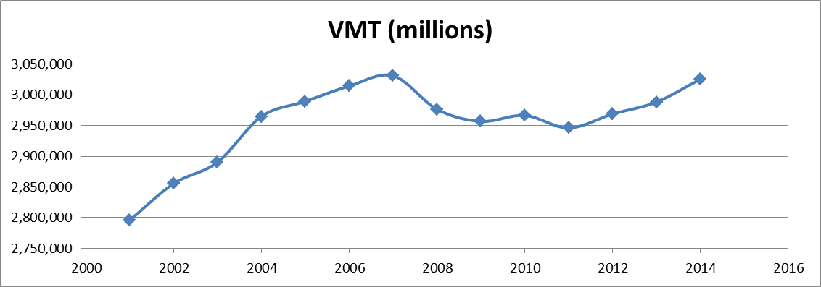
Exposure Measure

Slide 6
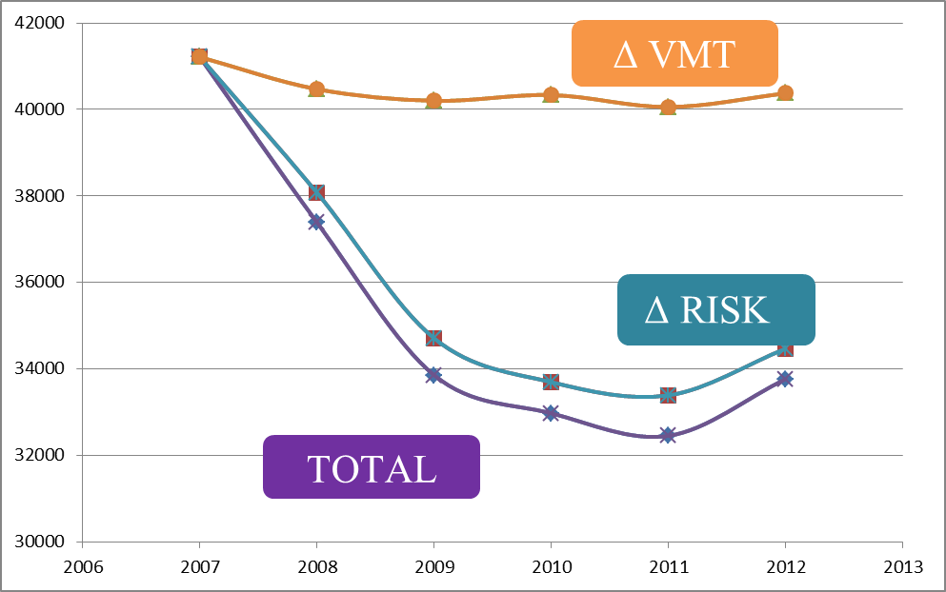
Constant Risk or VMT
vs
Total Fatalities
Notes:
Actually, these are all the same units: Fatalities
The graphs show what the fatalities would be if risk was constant and only VMT had varied: orange line
If VMT was constant and only risk had varied: Teal Line
And the actual

Slide 7
What caused risk to decrease?
Economic
Factors?
Safety and Capital Expenditures?
Vehicle
Safety?
Safety Regulations?

Slide 8
Economic
GDP per Capita
% Unemployment for
16-24 year olds
Rural VMT
Beer Consumption
Median Income

Slide 9
Safety & Capital Expenditures
Per highway mile
Law enforcement
Education
Safety-related
Capital
HSIP Obligations
Capital Improvements

Slide 10
Safety Regulations
Ratings for:
DUI laws
Helmet laws
Occupant Restraint Laws

Slide 11
Vehicle Safety
Percent
of
Vehicle Fleet
1991
or
newer
Notes:
Am only showing most significant factors. Will note in presentation

Slide 12
Models
Negative Binomial Regression
Model Controlling for State Effects – MCS
Adjusts for the effects of state-associated unknown influences not considered in the model.
Model Not Controlling for State Effects – MNCS
Does not make a separate adjustment for other influences.
Change Model
Data translated into percent change from year to year within each state
Notes:
change model removes overall differences between states on all variables. Large states may have larger numbers of fatalities, larger expenditures, and larger numbers of miles driven, but change in those states is proportional. Small states do, however, produce more volatile change values because of the smaller samples.

Slide 13



Negative Binomial Regression
Model Forms
MCS
$$Fatalities=VMT×e^{\left(β_{0}+γ_{s}\right)+\sum_{i}{β_{i}X_{i}}}$$
MNCS
F$atalities=VMT×e^{β_{0}+\sum_{i}{β_{i}X_{i}}}$
Fatalities = VMT x Risk
Risk = $e^{β_{0}+\sum_{i}{β_{i}X_{i}}}$
Notes:
I think I have the models correct now, please verify

Slide 14
Modeling Results
MNCS Model
Prediction
MCS Model Prediction
Observed

Slide 15
Economic Factors
Economic Factors
MCS Model
Prediction

Slide 16
Modeling Results
+ Safety
& Capital Expenditures
Notes:
I am not labeling everything because I want to emphasize the difference made by the addition of the new factors. I think the progression will be clear in the presentation.

Slide 17
Modeling Results
+ Safety
Regulations

Slide 18
Modeling Results
+ Vehicle Safety
Observed

Slide 19
Negative Binomial
Most Significant Variables
≈ 85%
Economic
% Unemployment for
16-24 year olds
GDP per Capita
Median Income
Beer Consumption
≈ 12%
≈ 2 to 3 %
Safety Regulations
DUI laws
Vehicle Safety
Percent of
Vehicle Fleet 1991
or newer
Notes:
16 to 24 year old unemployment is 50 to 60% of total predicted decline
Unemployment for this group was twice the national average
And this group accounted for about half of the reduction in fatalities over this periodl
The insurance and car rental companies are right.

Slide 20
Change Model
Decrease Accounted for: 58%
16-24 Year Old Unemployment 29%
GDP and Median Income 16%

Slide 21
Takeaways
Both VMT and Risk varied over the study period.
It’s complicated:
Steady Safety Progress
Abrupt Economic Influences
Economic factors clearly affect :
VMT and Risk
All VMT (Driving) is not created equal from a risk perspective
Factors beyond the control of transportation professionals can have a large influence on traffic safety.

Slide 22
Implications for Safety Management
Safety Goal Setting
Can the Models help?
Despite advances in safety prediction tools and effectiveness of countermeasures:
Aggregated Data is lacking
We know we have effective countermeasures
Evaluation and Tracking are needed at the state level.
Notes:
On point 3, do not disagree—I think the reference is mainly to state DOT programs?
At the same time, it would be good to emphasize that there are a lot of effective tools within the scope of safety professionals that are proven to be effective (belts, crashworthiness, laws to improve safe driving behavior, crashworthy roads, etc.).

