Slide 1
Iowa LTAP Update
North Central Regional Meeting
2017-2018
May 22-23, 2018

Slide 2
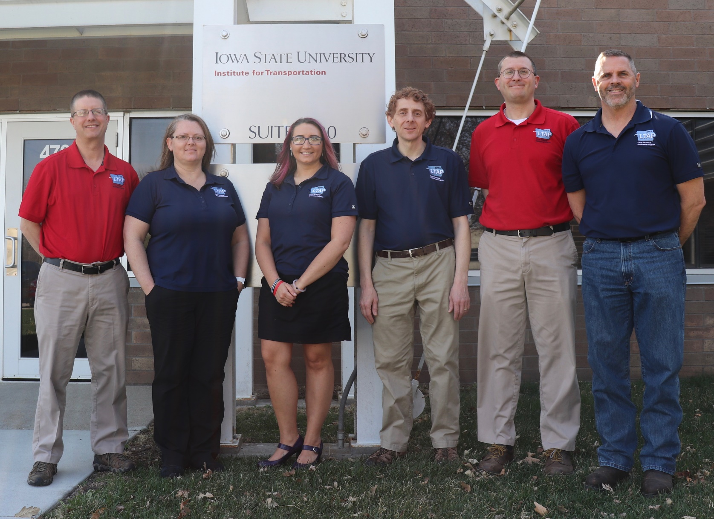
STAFFING
2

Slide 3
TRADITIONAL ACTIVITES
(2018 TO DATE)
3

Slide 4
EVENTS/WORKSHOPS
County & City Public Works Research/Innovation Focus Groups
Team Development (APWA)
Public Works Operations Safety (APWA)
Motorgrader Operator Training
Flagger/Work Zone & DOT Work Zone
MUTCD Review
4
Notes:
Proposal has 2200 from first 9 months.
Estimate is more like about 3,000 with GIAC Other.
Including estimates for the rest of year and GIAC Other – likely over 4,000.
Including December ICEA meeting, etc.
Increase of 25 percent.
2,558 from 2010.
Probably can’t keep this up.

Slide 5
EVENTS/WORKSHOPS #2
County Engineers Spring Conference
Bridge Inspection Trainings
Accessible Sidewalk/Curb Ramp Design/Construction
Greater Iowa Asphalt Conference
Underground Utilities Construction Inspector School (MN APWA)
OSHA Ten Hour Training
Leadership Institute
5
Notes:
Proposal has 2200 from first 9 months.
Estimate is more like about 3,000 with GIAC Other.
Including estimates for the rest of year and GIAC Other – likely over 4,000.
Including December ICEA meeting, etc.
Increase of 25 percent.
2,558 from 2010.
Probably can’t keep this up.

Slide 6
LEADERSHIP INSTITUTE
Accredited by National APWA (1 of 18)
15 Online Trainings to Develop Local Management/Leadership
Only On-Line Self-Paced Version
Audience: New Supervisors and Others
“Those aspiring to become leaders”
Courses Intended to Increase Managerial Skills and Abilities
Updating/Recording Courses at Iowa APWA Spring Meeting Annually
50 graduates
6

Slide 7
PLANNING (2018)
Fracture Critical Inspection Techniques for Steel Bridges (NHI)
Local Road Safety Series
County Engineers Midyear, Fall, and Annual Conferences
Road Safety Assessments
Potentials: Math, OSHA, and Plan Development
7

Slide 8
OTHER ACTIVITIES
On Call Safety Meeting Assistance
Digital Ball Bank Loan
“Free” Video Streaming Service
Statewide Mousetrap Competition
Road Scholars Program
Funded: Wood Piling Test Kit Purchase (to Loan)
Funded: Speed Feedback Sign Purchase (to Loan)
8
Notes:
Proposal has 2200 from first 9 months.
Estimate is more like about 3,000 with GIAC Other.
Including estimates for the rest of year and GIAC Other – likely over 4,000.
Including December ICEA meeting, etc.
Increase of 25 percent.
2,558 from 2010.
Probably can’t keep this up.

Slide 9
“SOTP” ACTIVITIES
RSA and Assessment Guidance (Finished)
Investigating the Necessity and Prioritizing Pavement Markings on Low Volume Roads
Local Retro Data Summary
National Rural Safety Center Activities (e.g., Low Cost Safety Improvements)
National Work Zone Safety Technical Assistance
IDIQ NHI Training Instructor Selection
Work Zone Sign Package Program (Part 2)
9

Slide 10
INNOVATION
ACTIVITES
(2017 and 2018 To Date)
10

Slide 11
KICK OFF (2017)
Identify EDC-4 Selections & Champion Contacts in Iowa
Increased Innovation Communication
  Locals Agencies and Associations
  State DOT Offices
  Staff & InTrans Researchers
“Innovation Iowa” Discussions & Information Gathering
  Local Interest
  InTrans Involvement
Innovations: “Home Grown”, EDC, or Both
Collaboration: LTAP/DOT/Service Bureau
11

Slide 12
FIRST STEPS (2017)
“Mousetrap” Expansion
Website & Listservs
Newsletter Articles
STIC Teaming/Funding Suggestions
Agenda Incorporation
  Hydro-Demolition on Bridge Overlays
  Bridge Abutment Rehabilitation Innovations
  Excavator Attachment Pile Driving
  Creative Approaches to Bridge and Structure Replacements
  Bridge Innovations with County Forces
  Work Zone Traffic Control Options and Innovations
  High Friction Surface Treatments
Local Stakeholder Partnering Committee
12

Slide 13
ACTIVITIES/WORKSHOPS (2017)
Assisted w/ Ultra High Performance Concrete (UHPC) Workshop
Converting Four Lane Undivided Roads to Three Lanes: A Low Cost Safety Improvement
Self-Cleaning Multi-Barrel Culvert Design Workshops
Cost Savings and Sustainability of Recycled Materials along Unpaved Roadways Workshop
County and City Research/Innovation Focus Groups
13

Slide 14
ACTIVITES/WORKSHOPS (2018)
Bridge Deck Epoxy Injection Workshop/Webinar
2D Hydraulic Modeling of Rivers at Highway Encroachments
InTrans Innovation Demonstration and Training Day
Recycled Asphalt Shingles and Gravel Road Project Open House
Statewide “Mousetrap” Competition
14

Slide 15
PLANNING (2018)
Local Agency Bridge Innovation Days (June)
Bridge Deck UHPC Workshop (June)
Pedestrian Safety in Small to Medium Sized Cities Peer Exchange (June)
Iowa Innovation Conference (October)
Local Agencies and EDC in Iowa (October)
Bridge Deck Epoxy Injection Project Open Houses (Various)
Pavement Preservation Project Open Houses (Various)
15

Slide 16
CONCLUDING THOUGHTS
Case by Case Evaluation: Need, Workload/Ability, and Alt. Methods
Continue Traditional Activities/Workshops Based on Results
Grow Innovation Activity
  Incorporation
  Home Grown, EDC, or Both
  Communication/Collaboration with Partners
Inspiration can Come from Anywhere
16

Slide 17
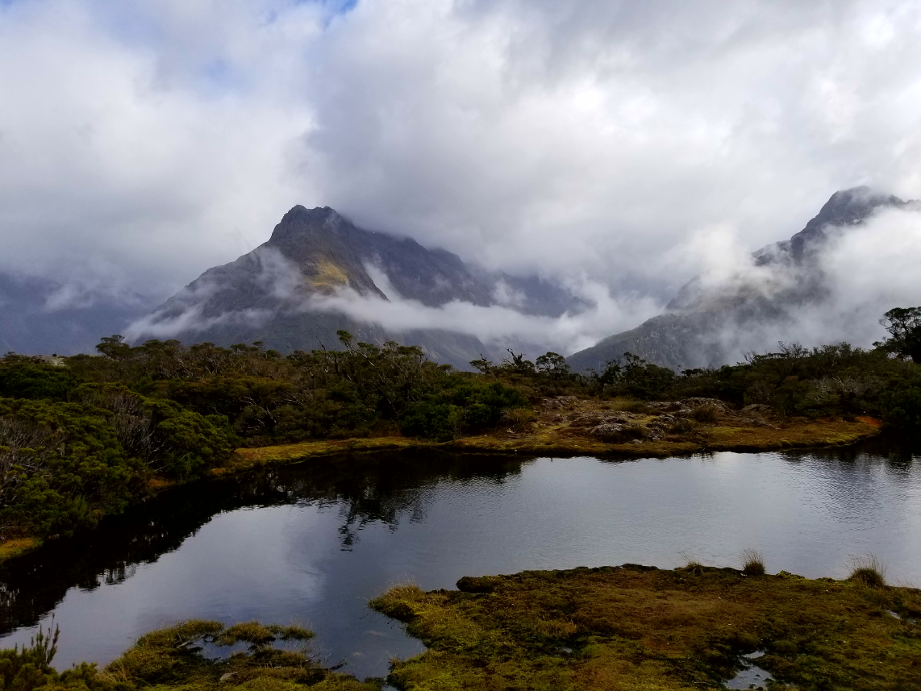
Questions & Discussion
David Veneziano
Iowa LTAP
dvenez@iastate.edu
515-294-8817

