Slide 1

Kentucky LTAP
Technology Transfer Program
Martha Horseman, LTAP Director

Slide 2
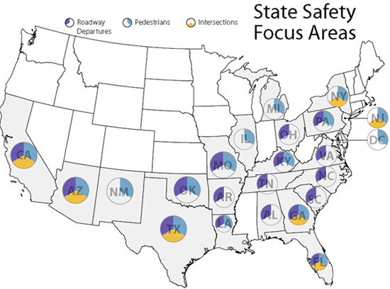
ASAP: Accelerated Safety Activities Program
Funds awarded to Safety Focus States by FHWA
12 projects awarded
KY LTAP was awarded funds for the Traffic and Safety Academy and Kentucky Traffic Safety Data Services
Notes:
Kentucky LTAP was in competition with all other 23 LTAP’s. 20 projects were submitted for funding and only 12 were selected.
Academy = $8,350, actual $7,485
Data Services = $7,250, actual $2,188

Slide 3
Marketing
Advertised in the Link newsletter
Mailings to local governments
Presentations at partner and association meetings
Discussed at exhibits
Promoted at training events
Past Roads Scholars…

Slide 4
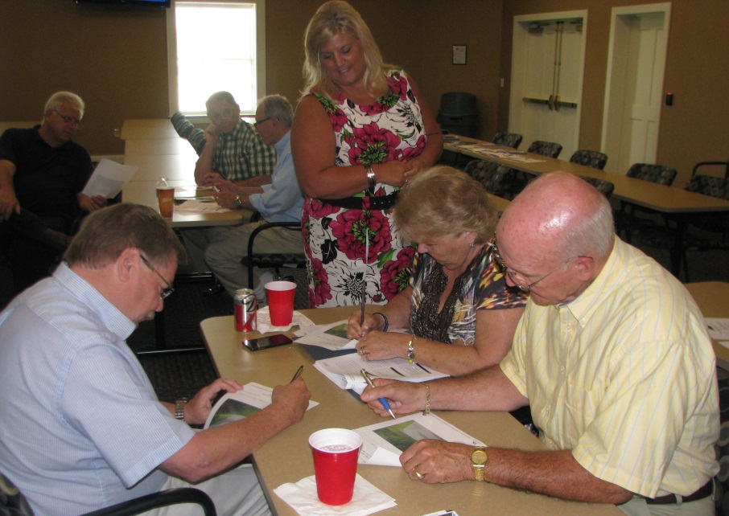
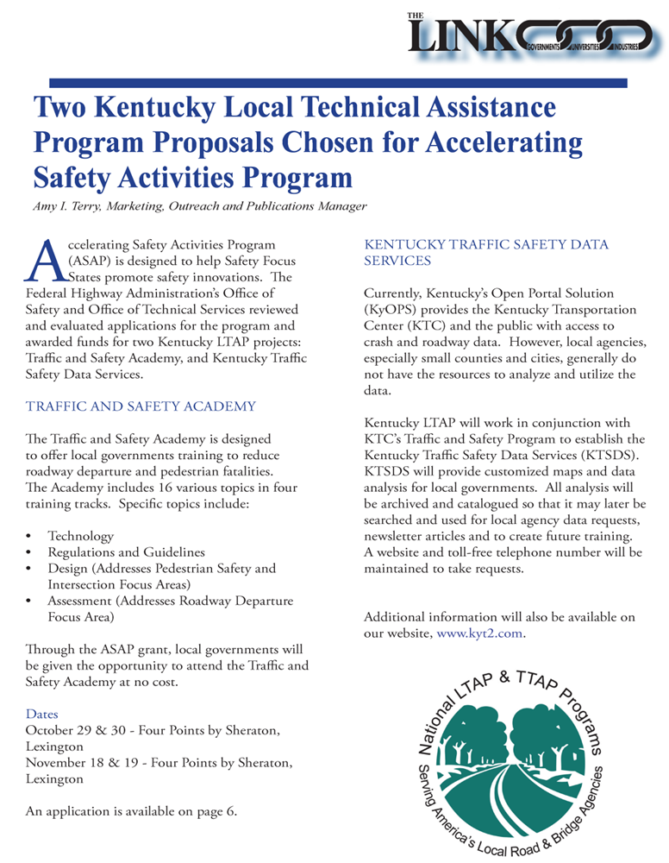
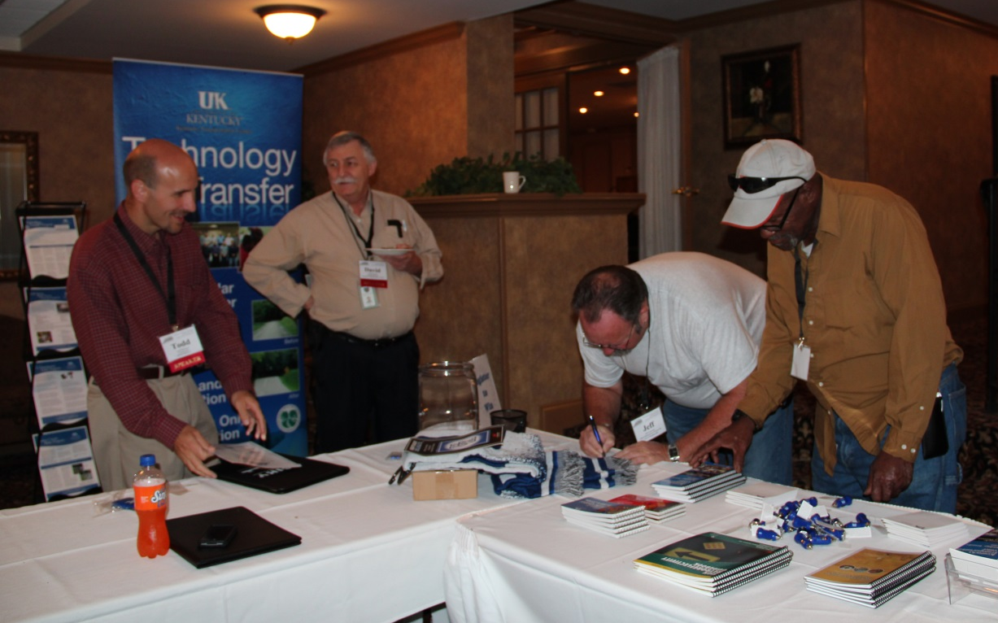
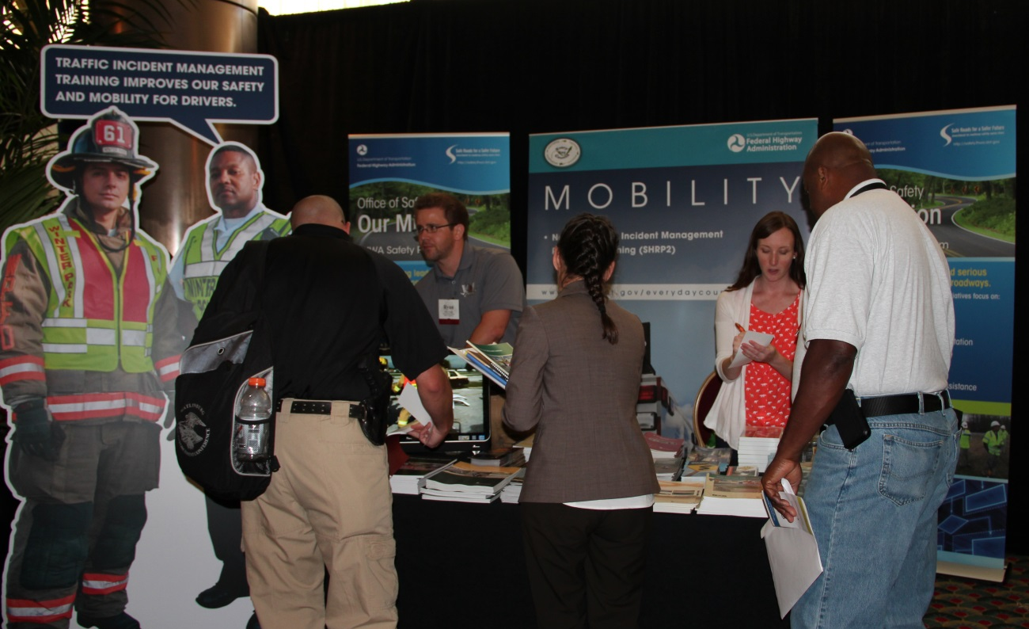

Slide 5
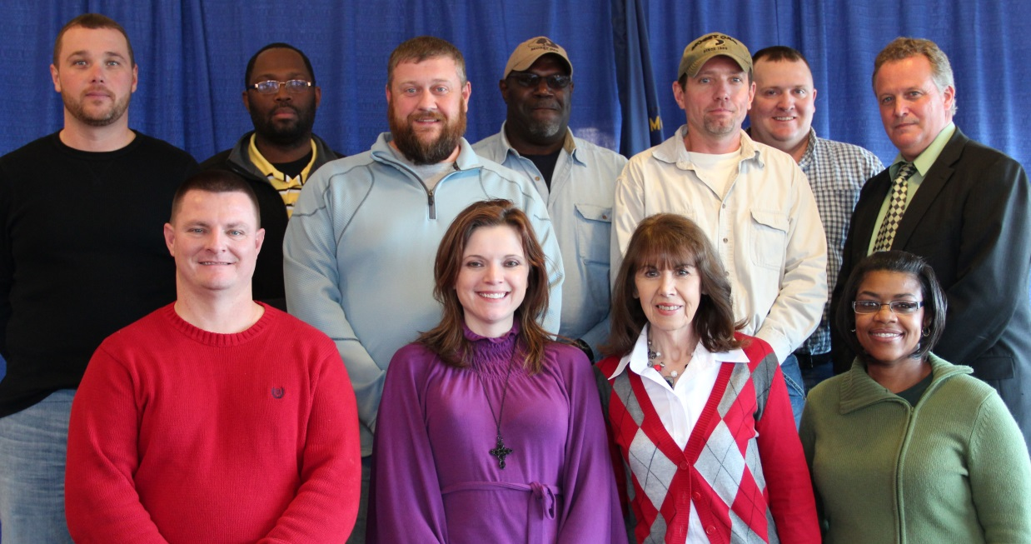
Roads Scholar and Road Master Programs
In 2013, 206 participants completed the Roads Scholar and Road Master Training Programs. This brought our total to 2,388 Roads Scholars and 1,769 Road Masters.

Slide 6
Traffic and Safety Academy
FREE
Designed for local governments to reduce roadway departure and pedestrian fatalities
16 topics covered in four training tracks
  Technology
  Regulations and Guidelines
  Design
  Assessment
Notes:
Kentucky LTAP was in competition with all other 23 LTAP’s. 20 projects were submitted for funding and only 12 were selected.
This was a great workshop for local governments to interact. Here are two county engineers: Duane Campbell and Buan Smith.
We were fortunate to have several Center, Cabinet and FHWA speakers over this four-day event.
We have submitted this article to the FHWA Safety Compass, and since they’ve asked for pictures and additional information, we are looking forward to it being in this publication.

Slide 7
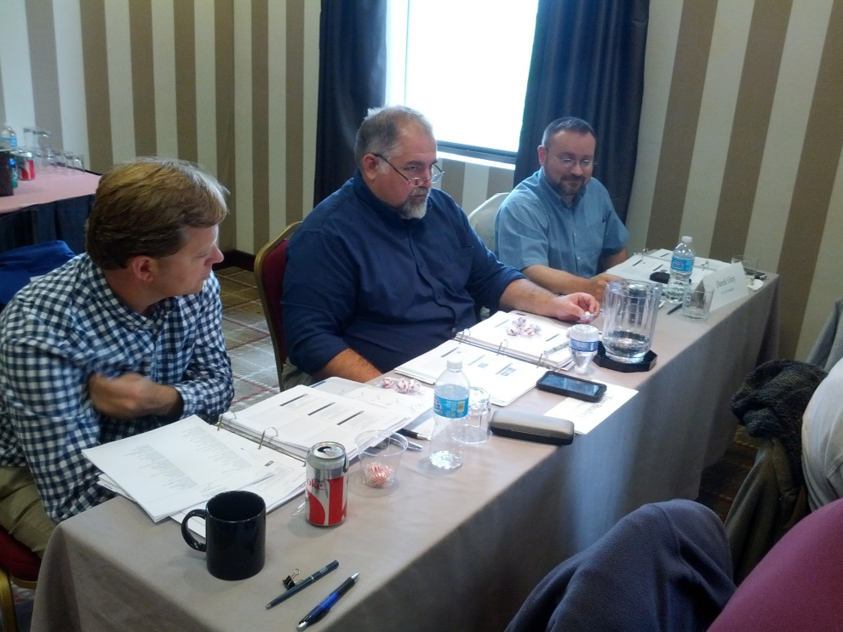
Traffic and Safety Academy
25 participants, 19 attending all four days
Managers asking staff to attend on particular days
Ten instructors over four days from LTAP, Ky Transportation Center, Ky Transportation Cabinet and FHWA – Ky Division
Notes:
Todd Morrison
Ken Agent
Eric Green
Tony Fields
Greg Rawlings
Deneatra Henderson
Ryan Tenges
Martha Horseman
Safety Circuit Rider, Jeff Hackbart
Dina Johnson

Slide 8
Daily Topics
Day 1
  Low-Cost Safety Improvements on Rural Roads, Road Safety Audits, Safety Countermeasures
Day 2
  Horizontal Curve Alignment, Guardrail, Asset Management,
Day 3
  Sign Retro, Systemic Safety, GIS Mapping, ADT, Highway Safety Manual
Day 4
  Risk Management, Pedestrian and Bicycle Safety, HSIP, SHSP
Notes:
Pulling out laptops for table to review data.
Topics the first day included Low-Cost Safety Improvements for Rural Roads, Road Safety Audits, and Safety Countermeasures for Roadways such as rumble strips/stripes, roundabouts, reflective backplates, corridor access management, and road diets.
Day two topics included Horizontal Curve Alignment, Guardrail Installation, and Asset Management for Roadways. During the Horizontal Curve Alignment discussion, participants were able to see and try out a ball bank indicator, which is available to check out through Technology Transfer’s Equipment Loan Program.

Slide 9
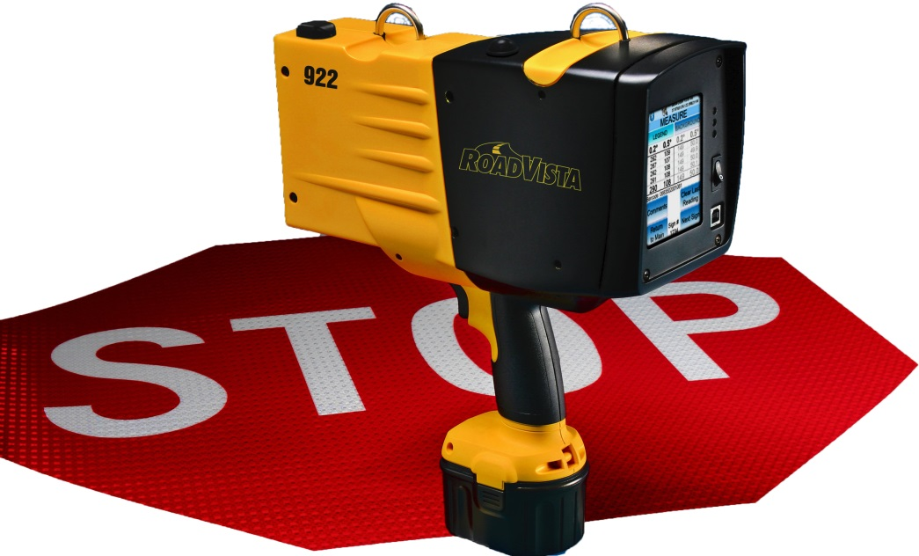
Equipment Loan Program
Free lending program for local public agencies in Kentucky
  Digital Ball Bank Indicator
  Calibration Sign Standards Kit
  Comparison Panel Standards Kit
  Digital Level
  Retroreflectometer
  Safety Edge Shoe
  Traffic Counter
Notes:
We are excited to continue to expand our Equipment Loan Program. We were able to add the Safety Edge Shoe last year and this year were able to acquire a Digital Level.
We have the opportunity during training courses to demonstrate this equipment which gives more explanation to participants of the class knowledge but also increases the usage of the equipment being used by local governments.

Slide 10
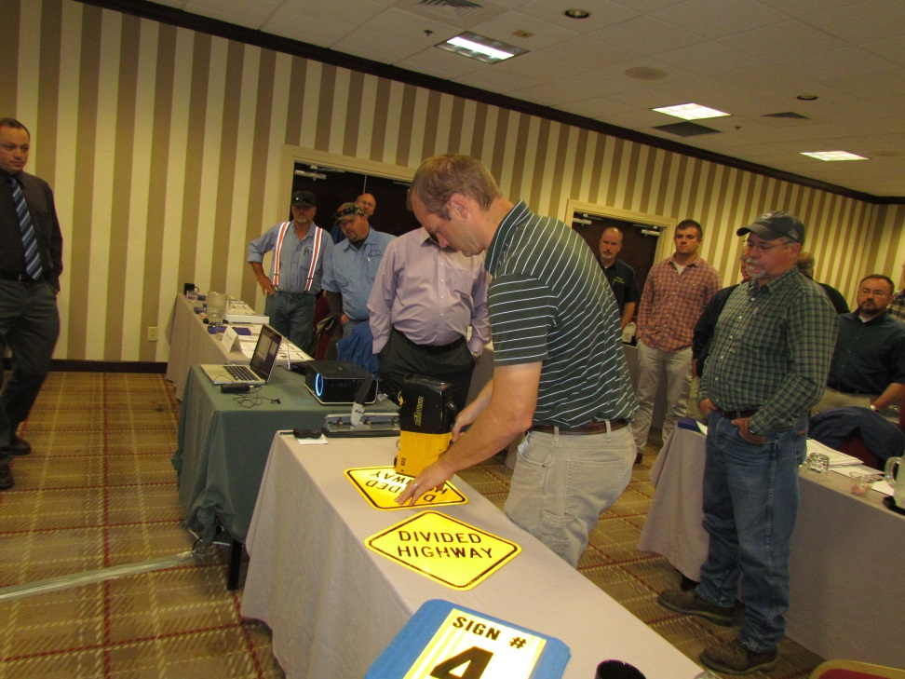
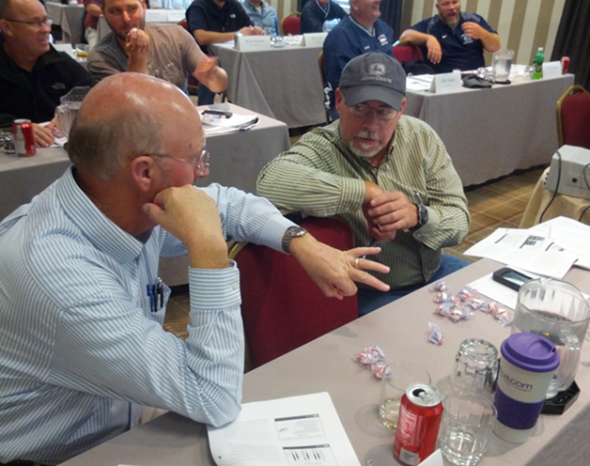
Hands-On Activities and Networking
“Good refresher,” said Luke Mantle, Road Supervisor for Campbell County.
“…very beneficial information and helps in my job,” said Doug Boom, Public Works Director, City of Henderson
Notes:
Built upon the RS RM model of learning with hands-on activities. Expanded topics taught within some of those courses.
Duane Campbell, Boyle County Engineer and Buan Smith, Woodford County Engineer. Networking is a key component in training.

Slide 11
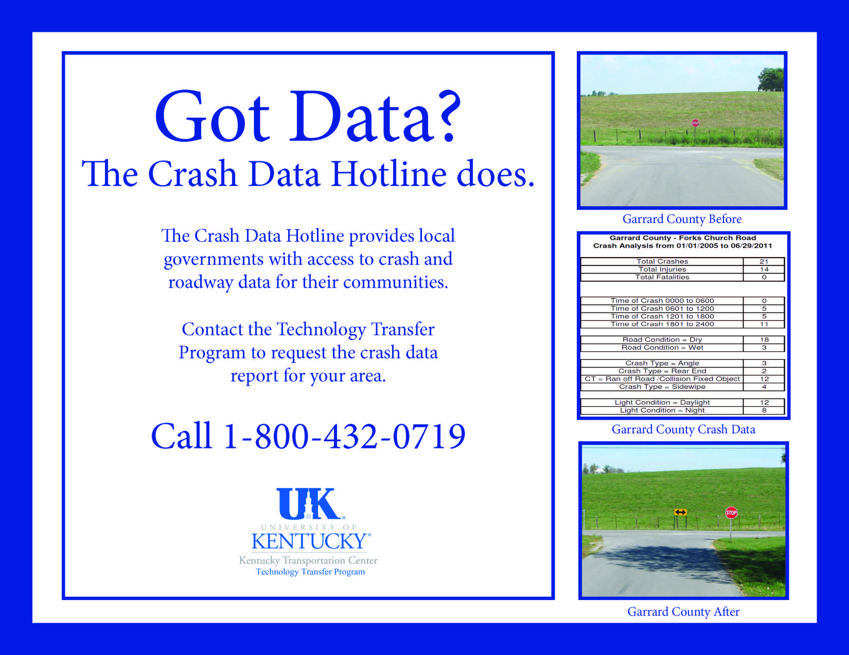
Kentucky Traffic Safety Data Services
Locals have access to crash and roadway data
However… locals generally do not have the resources to analyze and utilize the data
Worked with our Traffic and Safety Program
Provide customized maps and data analysis
Notes:
There is public access to crash and roadway data. However, local agencies, especially small counties and cities, generally do not have the resources to analyze and utilize the data. Expansion of Safety Circuit Rider Program

Slide 12
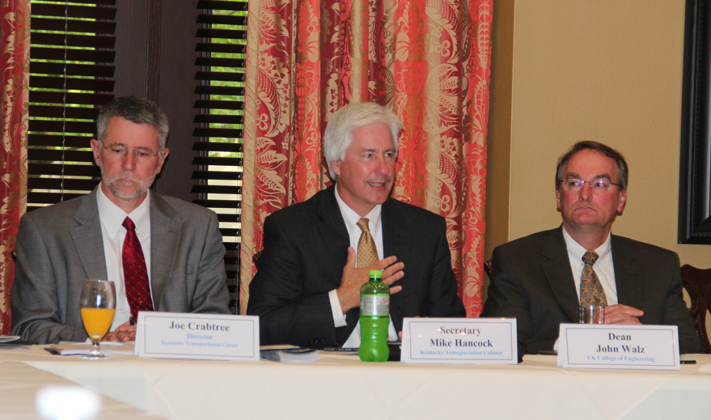
Advisory Board Meeting
May 2014
Project presented
Additional comments from our FHWA Division Director
Positive partnership with UK/Center, Cabinet, and FHWA
Notes:
Toot our own horn.
Representatives from local government associations.

Slide 13
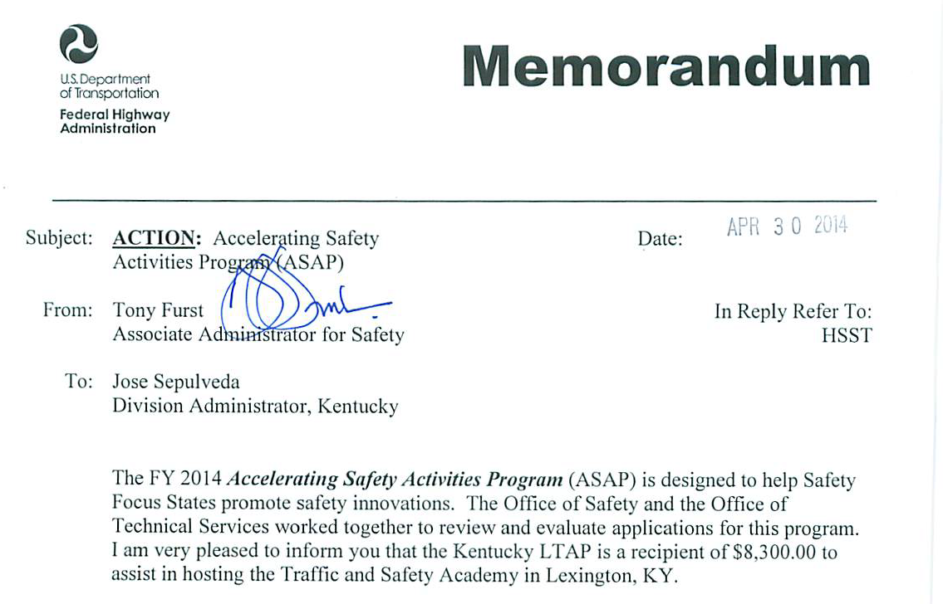
Notes:
We competed and again received notice that we received funding for the Traffic and Safety Academy.
Kentucky received such a positive response with the program we are happy to hold this training in the fall.

Slide 14

Showcase Our Work
Safety Compass Newsletter in Spring 2014: Volume 8 Issue 1
Follow up article in Link newsletter
Visibility for LTAPs/TTAPs, Kentucky, and Center

Slide 15
Kentucky Technology Transfer Program
Martha Horseman
Martha.horseman@uky.edu
859-257-4531
800-432-0719

