Slide 1
Nebraska LTAP Update

Slide 2
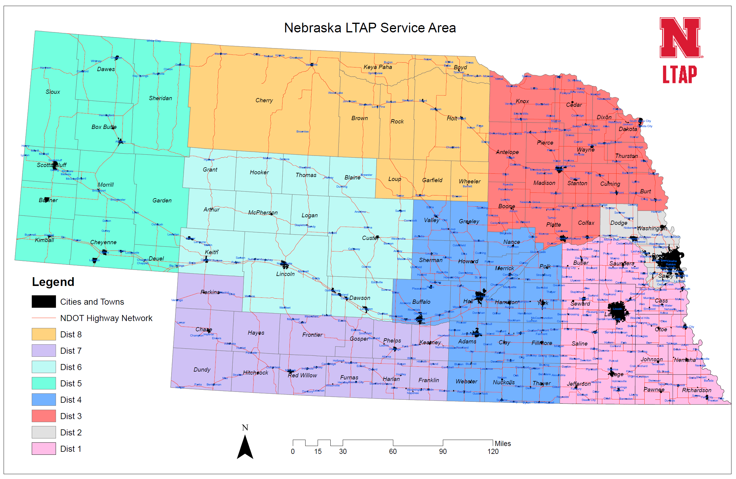
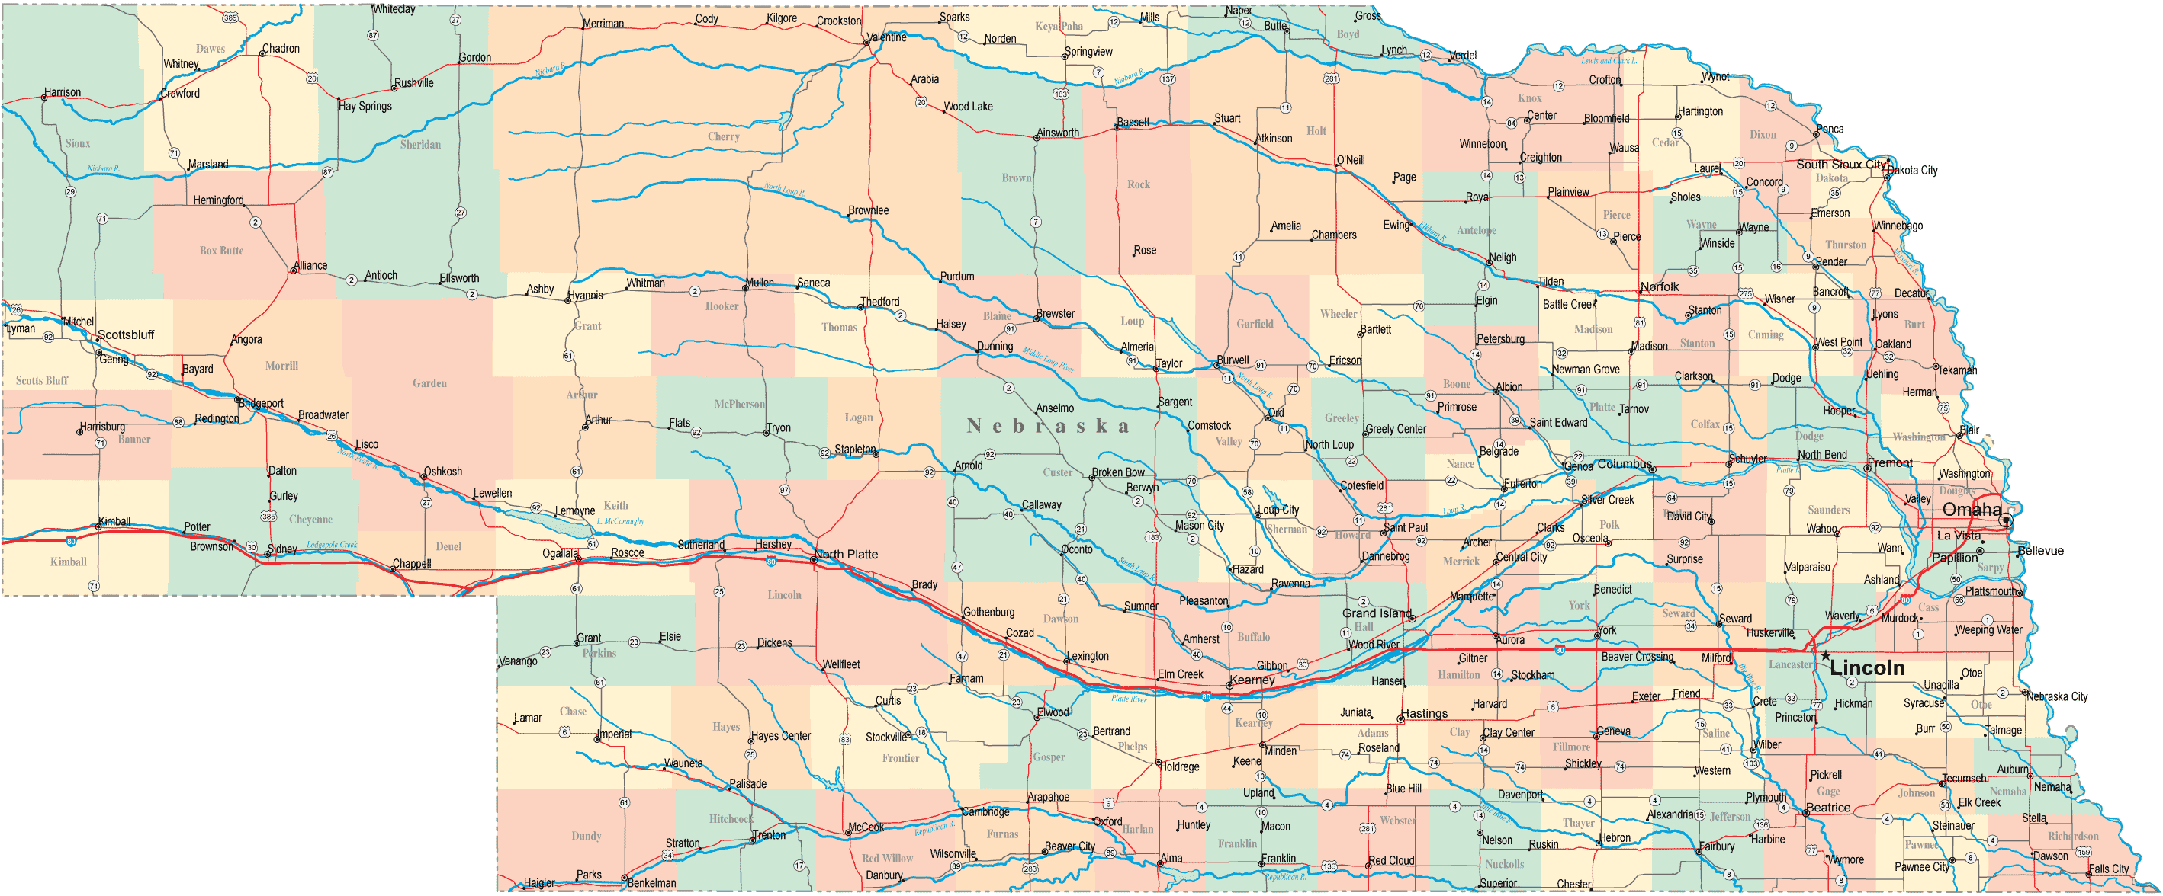
How well are we serving the State?

Slide 3

Heavy Equipment – Early Days
Survival & response
  In 2016, 65 heavy equipment courses (40% unique locations-mostly single day)
  In 2017, 21 heavy equipment courses (66% were unique locations-more multi-day)
  In 2018, on track for 37 heavy equipment courses (70% unique locations- mixture)

Slide 4

Heavy Equipment – 2017-18
Growth & Planning

Slide 5
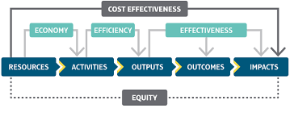
Planned Growth
Service to more counties
Efficient use of resources
Sharing model/resources with partners

Slide 6
GeoCD-CBA
Geographical Course Delivery- Cost Benefit Analysis
  Determine most efficient course delivery option by incorporating geographical location
  Weigh course delivery efficiency against effectiveness and equity
    1. Lincoln-based instructors on a geographical training calendar
    2. State-wide instructors teaching near home-base
Notes:
The growth of the program necessitated a switch to a geographical training calendar set bi-annually. Pro-active instead of reactionary (we contact the counties/cities in an area and schedule multiple sessions to limit travel costs. The next step is to determine the most efficient, effective and equitable method to deliver courses state-wide. There are two main types of program delivery we need to analyze (send trainers from Lincoln area across the state to regional trainings or move to an instructor pool located state-wide (not just Lincoln). Example- instructors hired in western Nebraska to train courses near their home-base. Developing a Geographical Course Delivery-Cost Benefit Analysis to weigh these costs and benefits before jumping in.

Slide 7
GEOCD-CBA contin.
Collecting data now
  Important variables Quantify
    Geographical organization of training calendar
    “Home-base” instructors
    Instructor wage type data
    Overall administrative burden of up-scaling
      Registration
      Reimbursements
      Invoicing
      Scheduling
Notes:
The GeoCD Cost Benefit Analysis will allow us to make policy decisions that best utilize our resources and while effectively serving our population. The most important step right now is data collection and quantifying all important variables. We need to determine the home-base of all employees in our instructor pool, availability, and competency. There are two different wage types (lump daily sum and hourly wages) that need to be incorporated into hiring decisions and program delivery. Finally, must determine the administrative burden to upscaling the program for both policy options and incorporate in to the CBA.

Slide 8
Shift towards Financial Analysis & Planning
Through CBA and modeling, determine most efficient, effective and equitable course delivery methods.
Developing other complimentary financial models
  Course Delivery Financial model to forecast expenditures
  Course specific financial modeling for larger financial commitments
Notes:
Nebraska LTAP is making an overall shift towards decision-making rooted in financial analysis and planning. This helps develop the institutional processes needed for financial modeling and strategic planning efforts. Specifically being utilized in a financial model to forecast expenditures/class registration cost by course type and smaller scale financial modeling for specific classes with a greater financial burden, such as our snow plow course.

Slide 9
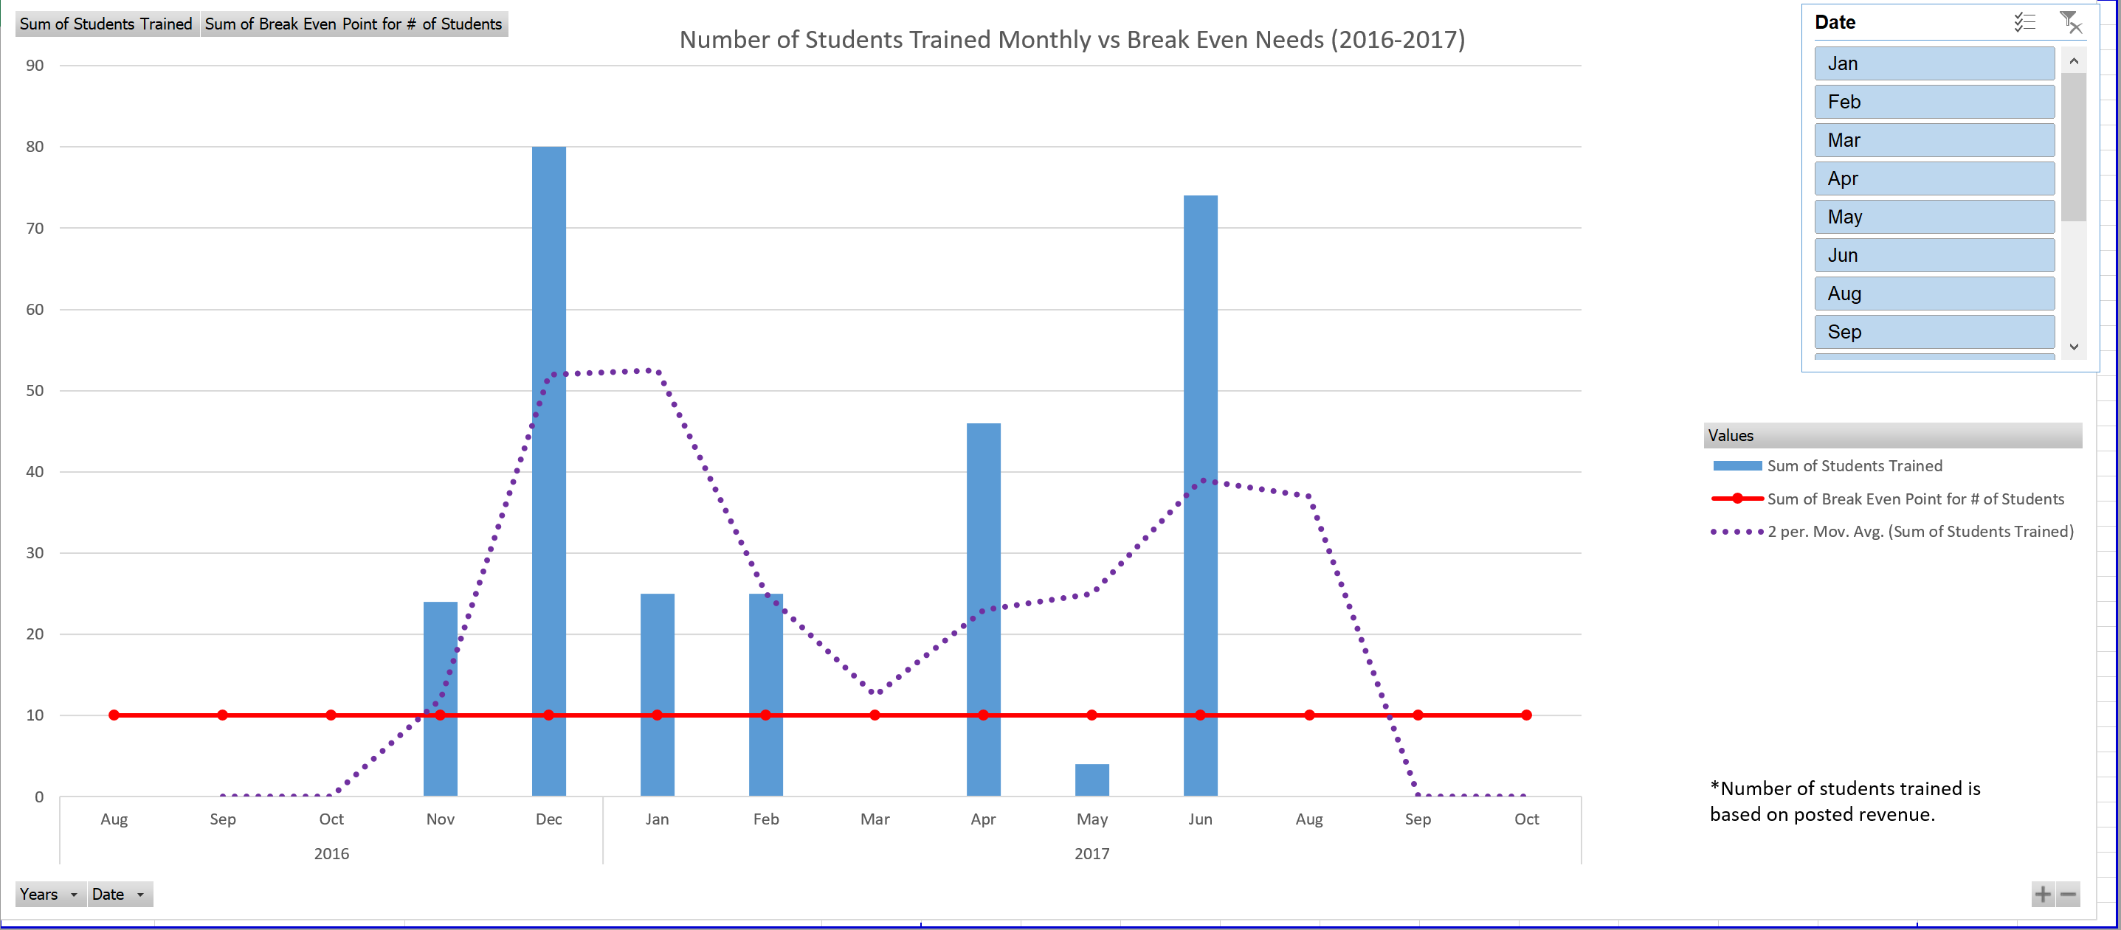
Snow Plow Course Financial Model
Notes:
This model shows the number of students we trained over 2 years in our snow plow simulator course, including a breakdown by month (the blue bars), our target for students trained monthly (the red line) and a two-month moving average (the purple dotted line) we can use to forecast next year’s snow plow course. This is then incorporated into the budget and policy making decisions.

Slide 10

Questions?

