Slide 1
Nevada LTAP Report
June 5, 2018

Slide 2
Highlights
Staff
Courses
Other Studies

Slide 3
Staff
  Same group as last three years
    Jim Nichols, Program Director
    Randy Bowling, Program Manager
    Linda Schoen, Office Manager
  Contract Manager-Ken Chambers, NDOT

Slide 4
Courses
Courses emphasized Road Scholar curricula
Generally offered 4 to 5 times throughout the state
Added new courses in Stormwater Pollution Control and Practical Math
Averaged about 22 enrollees per course presentation
By the end of the contract year we will have taught about 45 courses
Again, we find that the FHWA Resource Centers provide excellent courses in a cost effective manner.

Slide 5
Other studies
Contract with NDOT
  Two Tasks
    Study the pavement preservation techniques being used by the local agencies
    Investigate the use of UAVs in calculating the volumes of aggregate stockpiles
  Pavement Preservation
    Literature search and background investigation
    Develop questionnaire for local agencies
    Interview local agencies as to existing practices
    Develop matrix relating conditions and preferred techniques (successes)

Slide 6
Other Studies Continued
  UAV Studies
    Background
    Set experiment
    UAV acquisition
    Pilot certification
    Collect and analyze data.

Slide 7
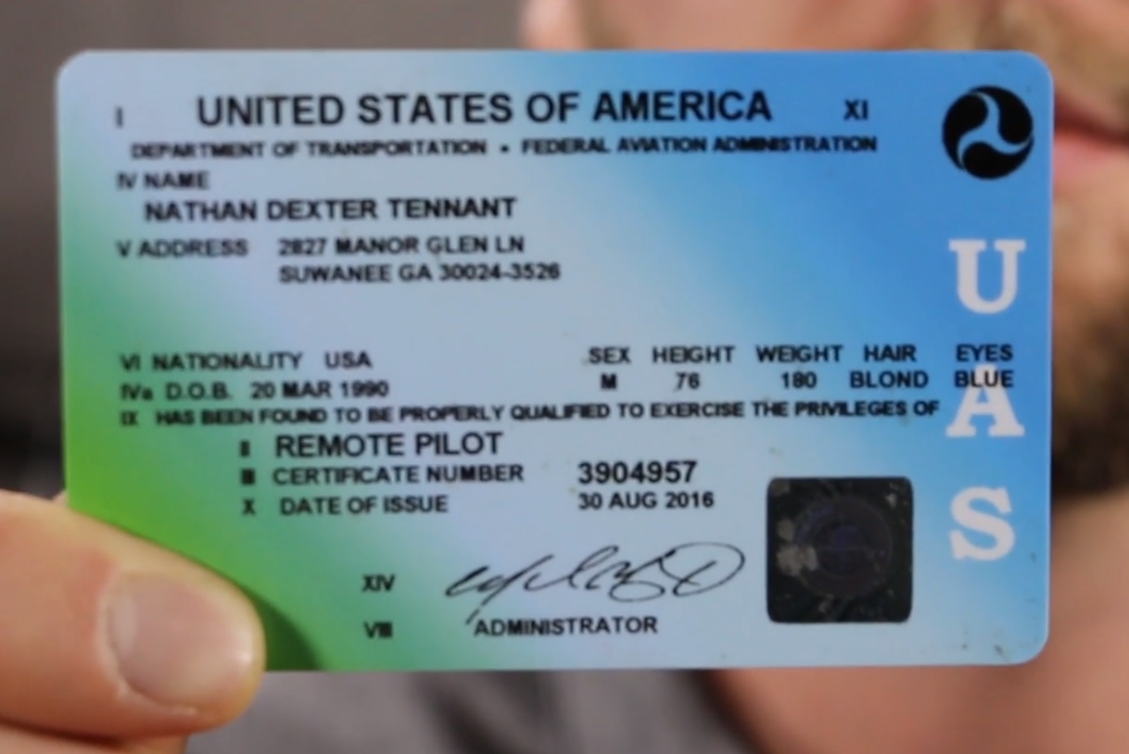

Slide 8
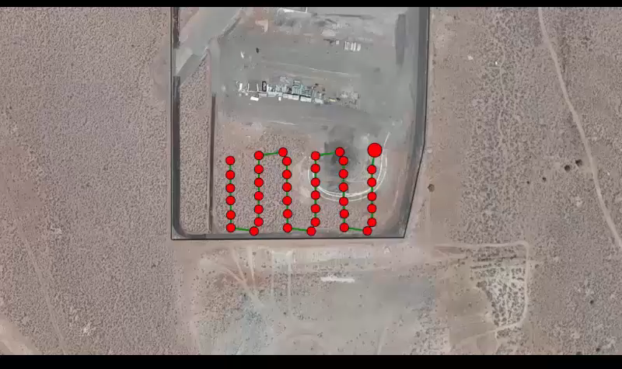

Slide 9
