Slide 1
Ohio LTAP – Accelerating Safety Activities Program (ASAP) Grant Awards
2012 & 2013

Slide 2
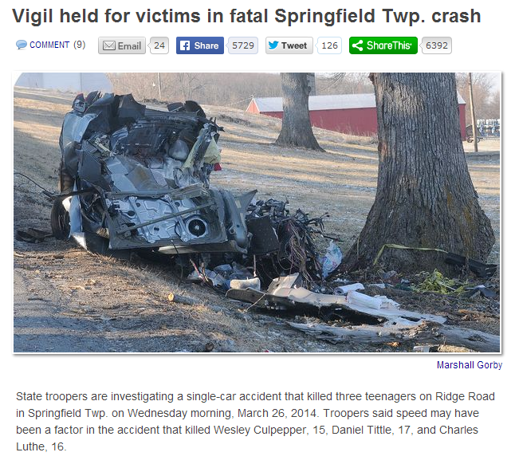

Slide 3

2012
Application #1
Ohio Local Roadways Systemic Safety Improvements Implementation Plan Safety Peer Exchange

Slide 4

2012
Application #2
Annual Ohio Local Roads Safety Conference

Slide 5
2013
Application #1
Roadway Departure Solutions – Focused Roadway Safety Training
13 Training Sessions
201 Participants Trained
Outstanding Post Course Surveys

Slide 6

2013
Application #2
Roadway Departure Solutions – Focused Roadway Safety Training eLearning Module Series

Slide 7
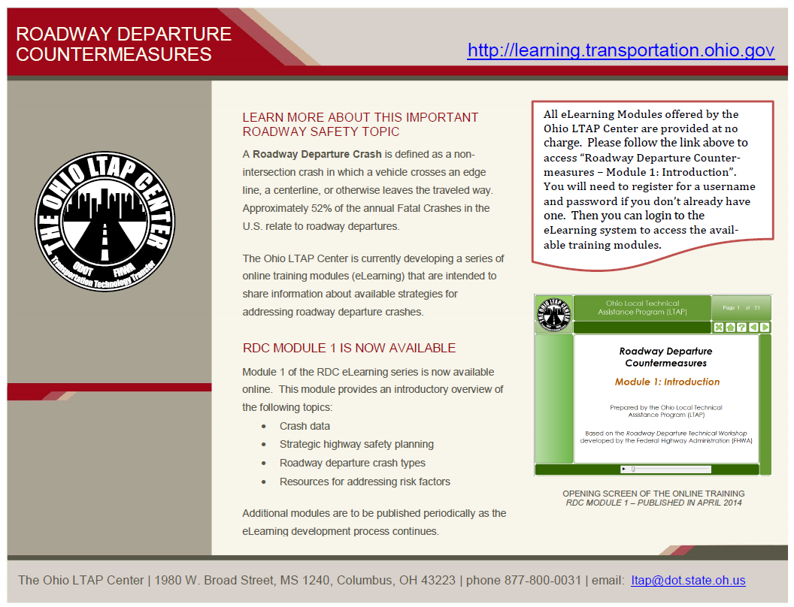

Slide 8


