Slide 1

Oregon T2 Center
Oregon
LTAP Western Region Meeting
June 5-6, 2018
Reno, NV
Technology
Transfer
Center
Notes:
We are a DOT based center and are housed in the Research Section. We have a total of 6 positions, which total 3.5 FTE.

Slide 2
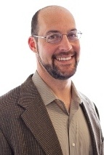
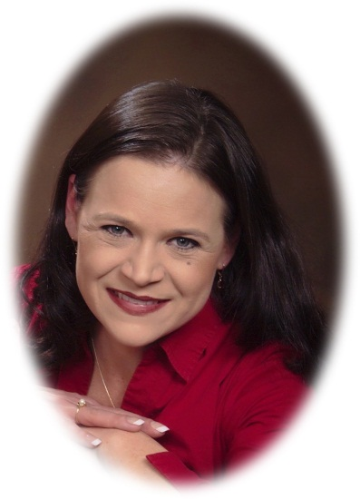
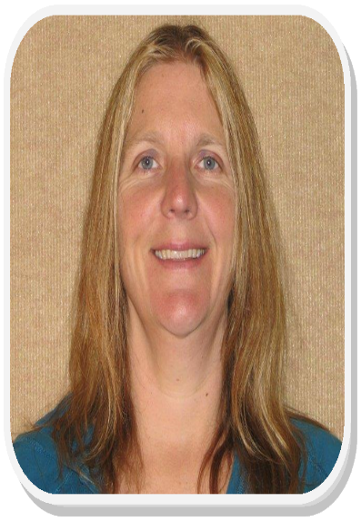
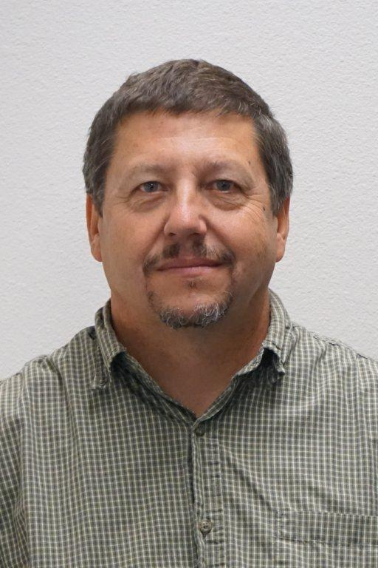
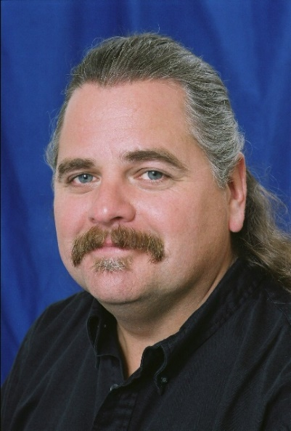
Staff
Michael Bufalino
Rebekah Jacobson
Sue Raynor
Tony Jobanek
Don Smith
Notes:
Current Staff

Slide 3
Staff Changes
Sue Raynor was hired in March 2017.
Linda Milligan took a rotational position in December 2017.
Michael Swan and the Safety Circuit Rider Program completed their pilot program in December 2017
After 15 years with T2, Bill Kolzow retired December 31, 2017.
Don Smith was hired April 2018 to replace Bill Kolzow.
Notes:
It seems to be a constant that we are hiring new staff.

Slide 4
Oversight and Steering Committee
We are having multiple retirements/resignations that are affecting our steering committee, so more recruiting will be going on this year.
Notes:
Need some fresh insight and desperately need representation from Tribes!

Slide 5
2017 Training Stats
262 Class offerings in 2017
4,926 participants, and
36,064 contact hours – an 8k increase from 2016!
Notes:
2016 Stats
255 Classes offered
6,234 participants
27,864 contact hours

Slide 6
Accomplishments
We have been able to fill all three trainer positions with qualified instructors!
Many courses are being updated.
Roads Scholar program is STILL going strong!
New Marketing methods continue to be successful

Slide 7
Struggles
Staff turn-over (retirements, etc.).
  We lost another Circuit Rider to retirement and our Training Coordinator to a promotion.
Databases in serious need of re-design.
Finding a tribal committee member

Slide 8
Goals completed for 2017
Filled Circuit Rider position.
Completed a successful Safety Circuit Rider program
Completed Ball Banking project for the locals
Delivery of Spring and Fall Roads Scholar classes.
Enhancing Partnerships within ODOT, with other LTAPs/TTAPs, AOC, and the Oregon Division FHWA.

Slide 9
Goals for 2018
Continue pursuing the development of online and video training.
Continue updating curriculums.
Continue marketing the Center.
Continue outreach to the tribes of Oregon.
Recruiting Steering Committee members - especially a Tribal committee member.

Slide 10
Contact Info
(503) 986-2855
T2Center@odot.state.or.us
www.oregon.gov/ODOT/TD/TP_T2

