Slide 1




Data Analysis and Use
NLTAPA Joint Safety Work Group Webinar
November 18, 2013

Slide 2
Data Analysis and Use
Safety Analysis for Local Agencies 1 day Workshop Overview
  Piloted in Washington State LTAP
Local Road Safety Plan Workshop
  1 Day Workshop – Colorado LTAP
Notes:
The HSM Applications with data (and the math) is optional depending on the audience.
Module 5 - HSM Roadway Safety Management Process will be presented in two parts A & B.
Part A will cover Chapters 4 (Network Screening), 5 (Crash Diagnosis), and 6 (Selecting Countermeasures)
Part B will cover Chapters 7 (Economic Appraisals), 8 (Prioritizing Projects), and 9 (Safety Effectiveness Evaluation)

Slide 3
Agenda
Safety Analysis for Local Agencies
Introduction
Systemic Project Selection
  Determine Problem Areas
  Select Countermeasures
  Prioritize Locations
Reactive Project Selection
  Determine and Analyze Problem Areas
  Select Countermeasures
  Compute a Benefit Cost Ratio
Wrap-up
Notes:
The HSM Applications with data (and the math) is optional depending on the audience.
Module 5 - HSM Roadway Safety Management Process will be presented in two parts A & B.
Part A will cover Chapters 4 (Network Screening), 5 (Crash Diagnosis), and 6 (Selecting Countermeasures)
Part B will cover Chapters 7 (Economic Appraisals), 8 (Prioritizing Projects), and 9 (Safety Effectiveness Evaluation)

Slide 4
Reactive Safety Projects
Long, proven history
Location based, usually intersections
Focus on high crash locations usually “total crashes”
Usually higher cost countermeasures are deployed
Minimal impact on fatal and severe injury crashes
Notes:
Key Message:
Part A contains three chapters – Introduction and Overview, Human Factors, and Fundamentals of Safety
Background: N/A
Acronym: N/A
Interactivity: N/A
Notes: N/A

Slide 5
Systemic Safety Projects
Short, proven history
Deployed over many locations or area wide
Focus on locations exhibiting characteristics linked to fatal and serious injury crashes
Usually low unit cost
Significant impact on fatal and severe injury crashes
Notes:
Key Message:
Part A contains three chapters – Introduction and Overview, Human Factors, and Fundamentals of Safety
Background: N/A
Acronym: N/A
Interactivity: N/A
Notes: N/A

Slide 6
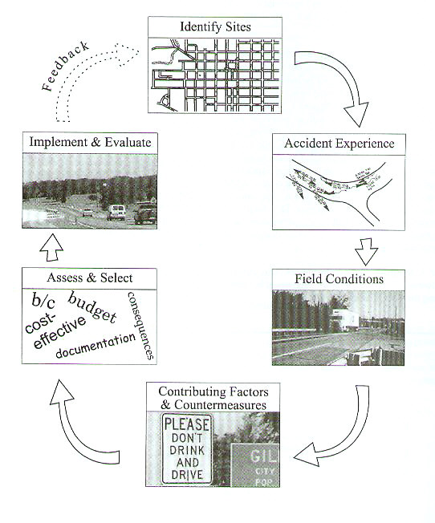
Safety Project Development
Identify Problem/Sites
Collect and analyze crash data
Inventory Field Conditions
Identify Contributing Factors and Countermeasures
Select Countermeasures
Implement and Evaluate
Notes:
Chapter 2 of NCHRP 440 details the crash mitigation process.
The crash mitigation process is divided into 6 steps as shown in the figure

Slide 7
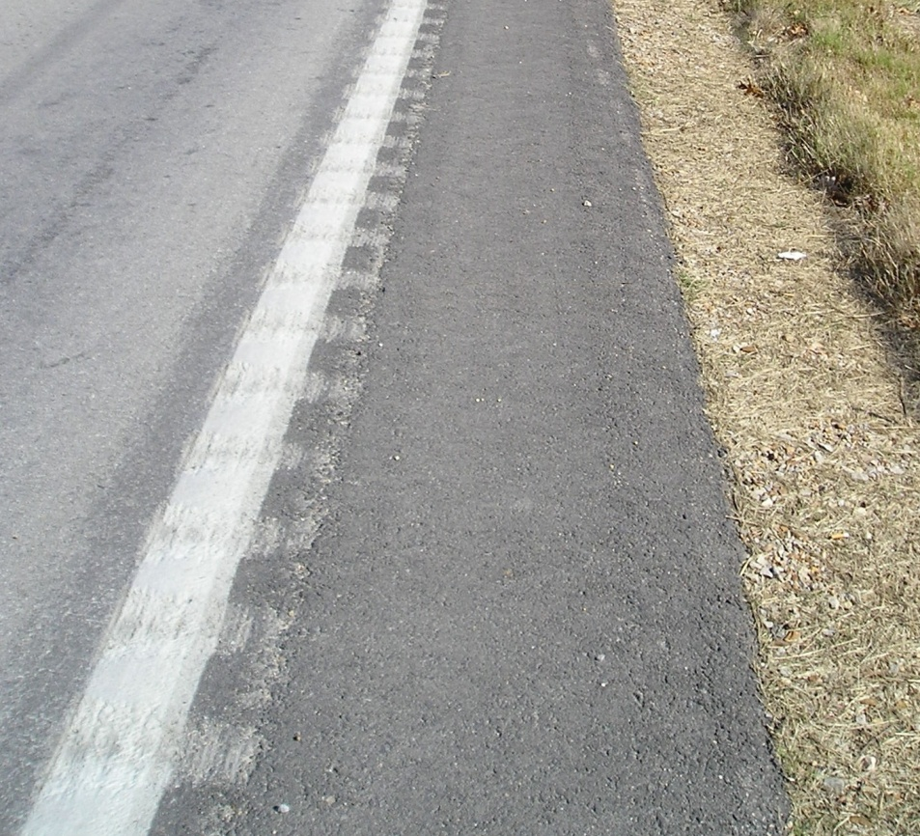
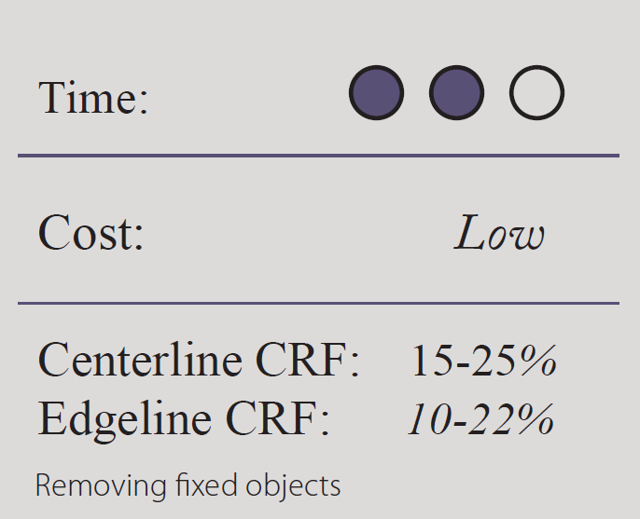
Roadway Countermeasures
Install Edgeline, Shoulder, or Centerline Rumble Strips/Stripes
Notes:
Main Points:
Rumble stripes are also beneficial for wet-night reflectivity.
Crash Type Addressed:
Run-off-road right, run-off-road left, and head-on crashed attributed to a vehicle leaving its lane of travel. Contributing circumstances include speeding, impaired driving, and inattention.
Where to Use:
Centerline rumble strips/stripes can be used on virtually any roadway – especially those with a history of head-on crashes. Shoulder and edgeline milled rumble strips/stripes should be used on roads with a history of roadway departure crashes. It is recommended that rumble strips/stripes be applied systematically along an entire route, instead of only at spot locations. For all rumble strips/stripes, pavement conditions should be sufficient to accept milled rumble strips.
Why it works:
Rumble strips provide an auditory indication and tactile rumble when driven on, alerting drivers that they are drifting out of their lane, giving them time to recover before they depart the roadway or cross the centerline. Additionally, rumble stripes (pavement markings in the rumble itself) provide an enhanced marking, especially in wet dark conditions.

Slide 8
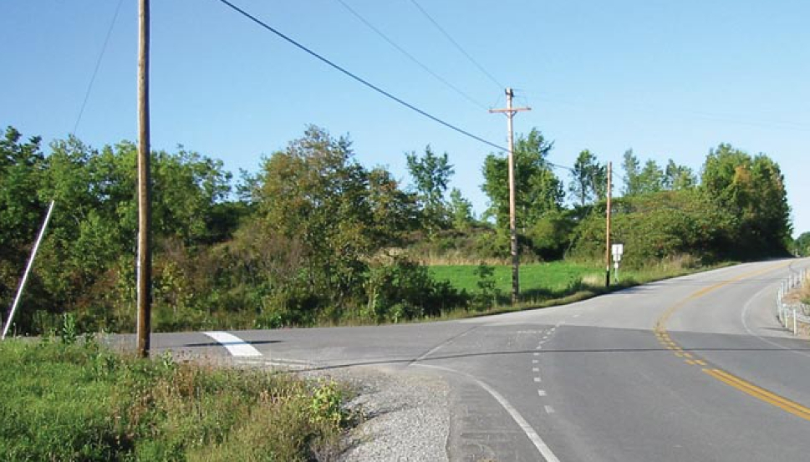
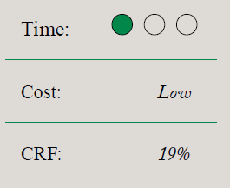
Intersection Countermeasures
Provide a Stop Bar on Minor Road Approaches
Improves visibility of the intersection for approaching vehicles
Notes:
Main Points:
Crash type addressed: Right-angle crashes attributed to drivers unaware of the intersection or failing to stop at the Stop sign.
Where to use: Minor road approaches where conditions allow the stop bar to be seen by an approaching driver at a significant distance from the intersection. Locations should be identified by patterns of crashes related to lack of driver recognition of the intersection.
Why it works: Providing visible stop bars on minor rod approaches to unsignalized intersection can help direct the attention of drivers to the presence of the intersection.

Slide 9
“Risk” Factors
“Risk” factors are criteria which are linked to the occurrence of targeted crashes
Examples of Road Departure Risk Factors on Segments
Crash Density – crash frequency
ADT
Access Density
Curve Density
Edge Risk – risk of hitting object or roll-over
Notes:
Prioritized candidate locations are then evaluated to determine how countermeasures will be deployed. This will depend on factors such as site characteristics, traffic volumes, agency practices/policies, coordination with other capital improvement programs, etc.
An important distinction in the systemic approach is the decision making process does not just identify the most appropriate countermeasure for each individual location, as done when addressing hot spots. The systemic approach considers multiple locations with similar risk characteristics, selecting a preferred countermeasure(s) appropriate and affordable for widespread implementation.

Slide 10
Learning Outcomes:
Reactive Project Case Study
Identify crash patterns from a crash diagram
From available data determine issues and potential countermeasures
Select most appropriate countermeasure for location
Notes:
Key Message:

Slide 11
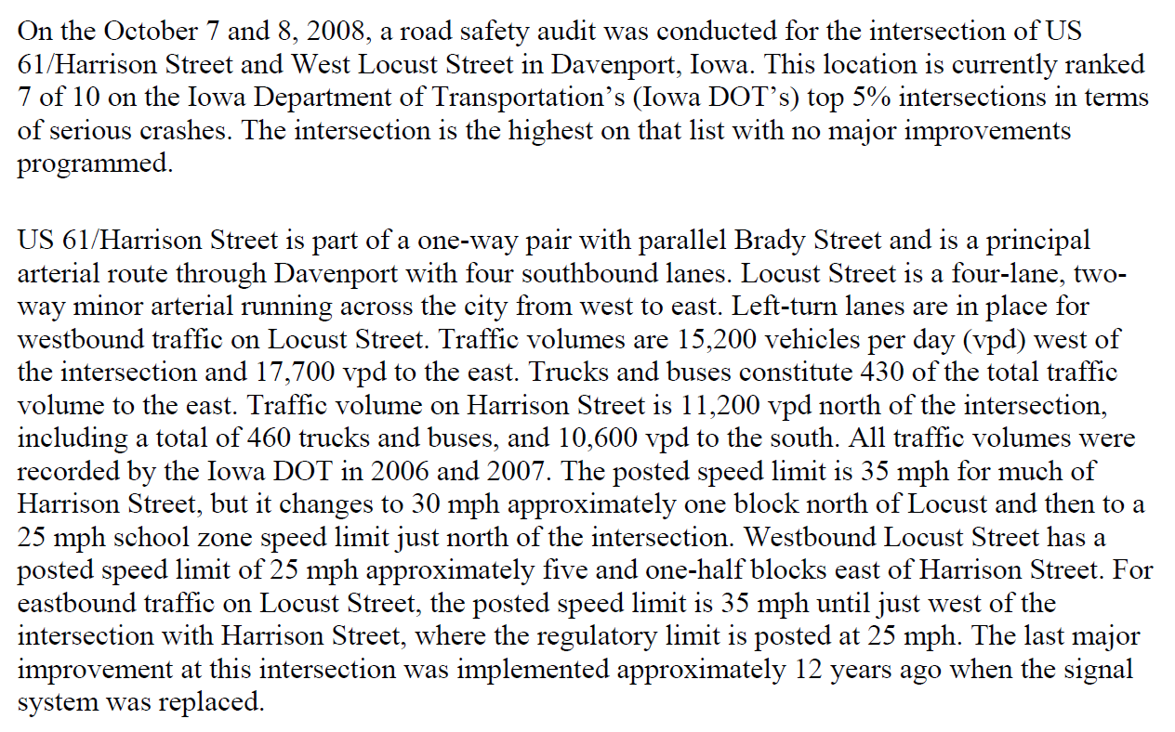
Iowa US 61 Example

Slide 12
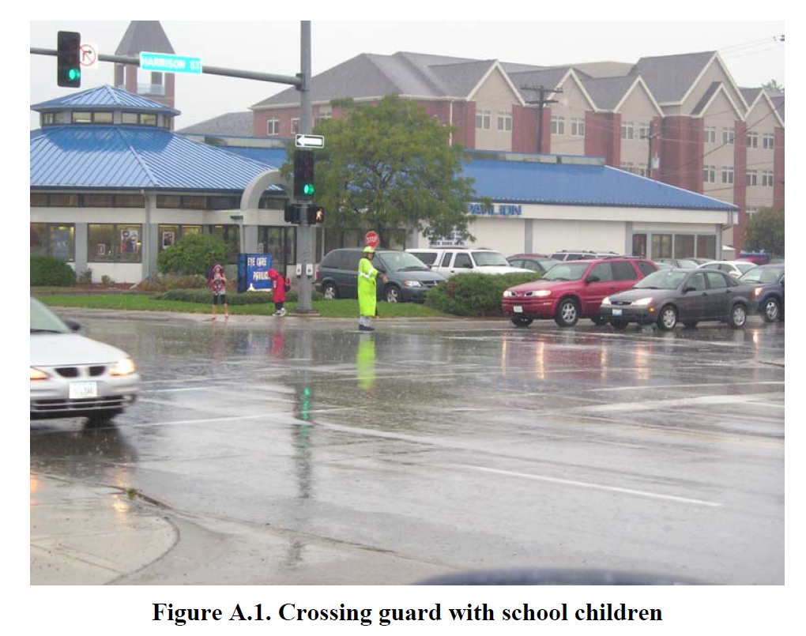

Slide 13
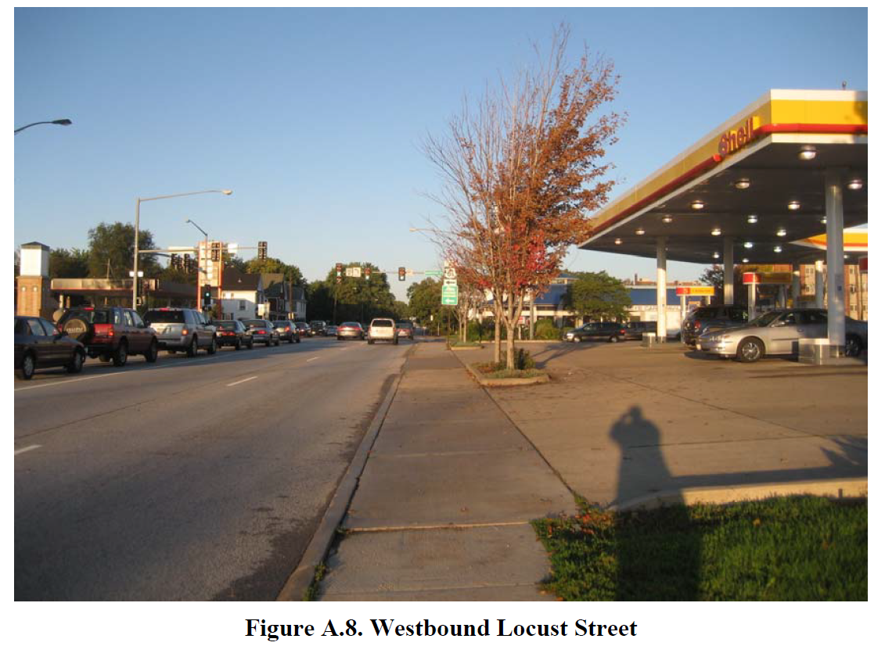

Slide 14
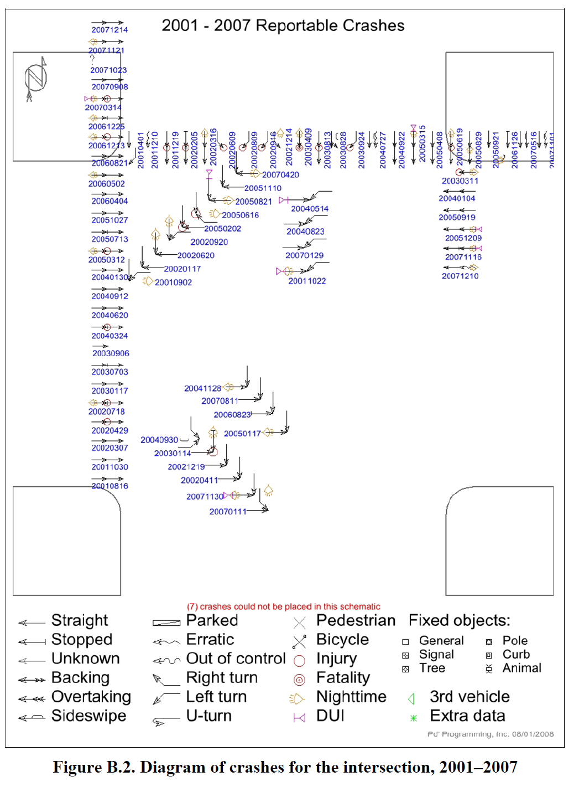

Slide 15
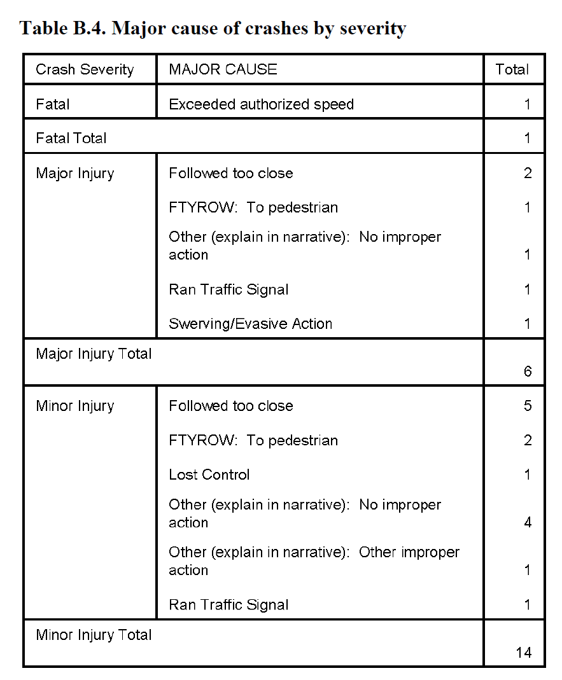

Slide 16
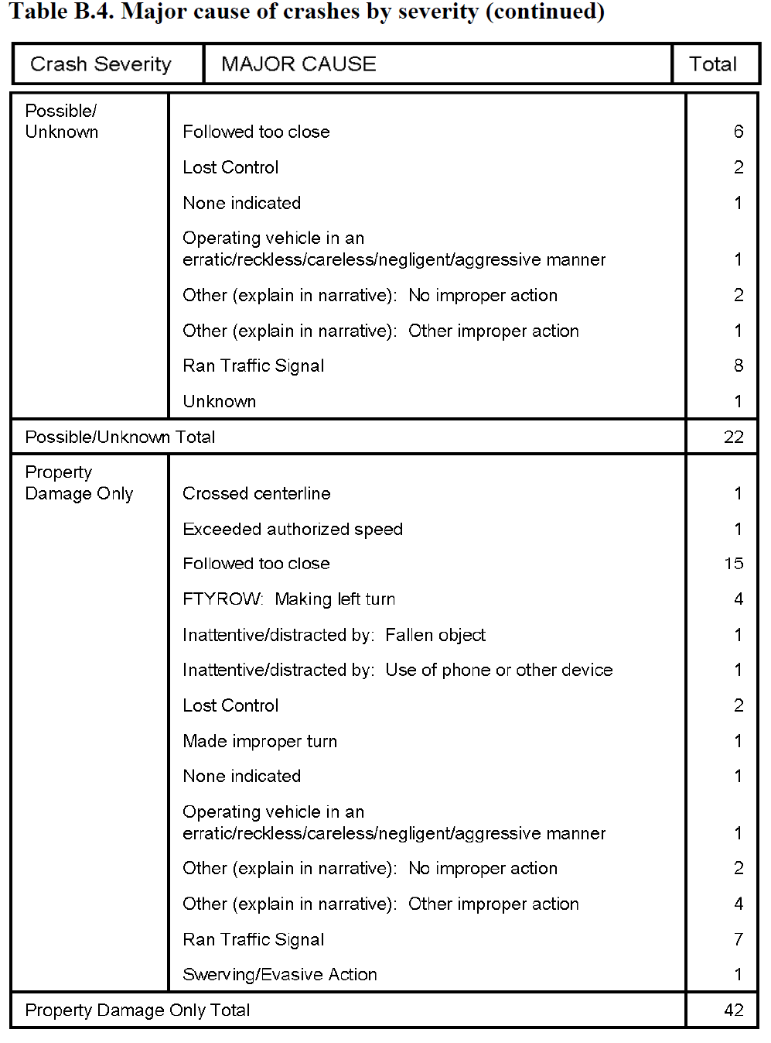

Slide 17
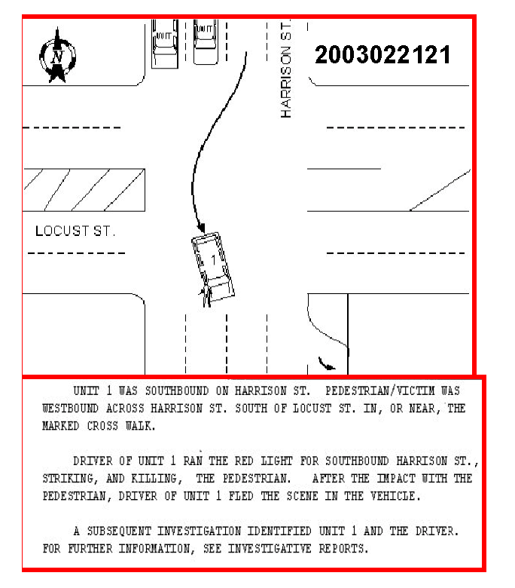
Police Sketch

Slide 18
Group Exercise
What crash patterns are apparent from the crash diagram?
What are the potential issues regarding this intersection?
What other data would be valuable?
What countermeasures would you recommend?

Slide 19
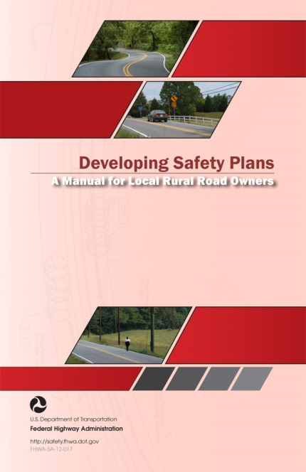
Local Road Safety Plan Worshop
Welcome and Introductions
Overview of Local Road Safety Plans
Colorado Safety Data and Plans
Examples of Local Road Safety Plans
Development of a Local Road Safety Plan
Wrap Up
Evaluation

Slide 20


Colorado SHSP, HSIP & Safety Data

Slide 21
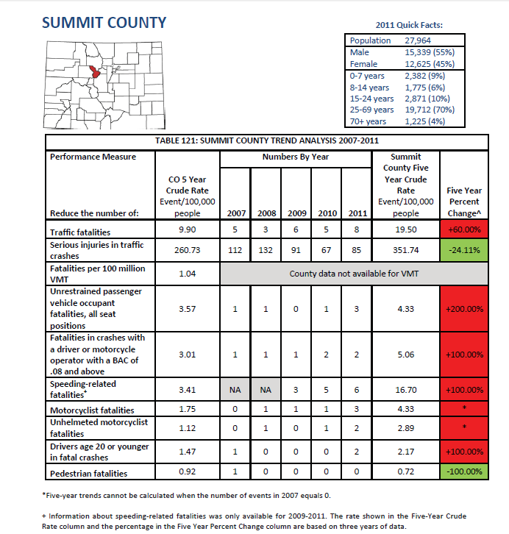
Safety
Data

Slide 22

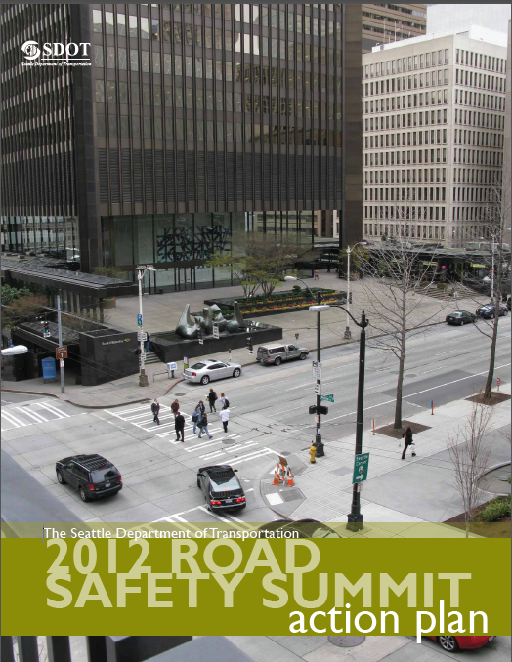

Slide 23
Development of a Local Road Safety Plan
Step 1: Establish Leadership
Step 2: Analyze the Safety Data
Step 3: Determine Emphasis Areas
Step 4: Identify Strategies
Step 5: Prioritize and Incorporate Strategies
Step 6: Evaluate and Update the LRSP

Slide 24
Questions and Discussion
Safety Analysis for Local Agencies
Notes:
The HSM Applications with data (and the math) is optional depending on the audience.
Module 5 - HSM Roadway Safety Management Process will be presented in two parts A & B.
Part A will cover Chapters 4 (Network Screening), 5 (Crash Diagnosis), and 6 (Selecting Countermeasures)
Part B will cover Chapters 7 (Economic Appraisals), 8 (Prioritizing Projects), and 9 (Safety Effectiveness Evaluation)

