Slide 1

MAP–21
Guidance on State Safety Data Systems
Robert Pollack
FHWA
November 18, 2013

Slide 2
Data-Driven Safety Challenges
What data to collect, how much to collect, what type of analysis to perform, and evaluation of safety improvement.
  FHWA tools to address these challenges include:
  Roadway Safety Data Program
Notes:
The number one challenge that states have in this area, is ensuring that their data is complete, timely and accurate. FHWA also must ensure that States are collecting and utilizing all of the data necessary to make good decisions – crash, traffic and roadway data.
To this end, we issued a guidance last summer on the Fundamental Roadway Data Elements that all states should collect in order to utilize a comprehensive data analysis.
We have worked with almost 1/3 of the states through the Crash Data Improvement Program (CDIP); which walks a state’s crash data partners through a workshop and knowledge transfer. We walk through their entire crash data process and offer them recommendations on how they can improve their crash data systems. We have posted the CDIP guide online for anyone to use.
We have conducted CDIP in Washington, New Mexico, Montana, Oregon, Utah, Alaska, Colorado and will conduct one in California on February 19. I want to recognize your staff for taking leadership roles in putting these events together and working with their states to follow up on corrective actions after they occur. In Alaska, for instance, Jack Stickel in their DOT has become a real advocate for our CDIP and Assessment and is steering his colleagues to us for assistance. In California, Randy Warden and Ken Kochevar put together a great data peer exchange last year and are now putting together a combined CDIP / capability assessment session.
We are expanding our technical assistance package this year by offering states the Roadway Data Improvement Program; which will perform the same services for states in the area of their roadway data. We are getting a great deal of interest from states on RDIP already, and will start rolling that out this summer.
We are also providing ongoing guidance, training and technical assistance to states as they begin to implement the Highway Safety Manual and systemic planning.

Slide 3
Major Themes of MAP-21
Strengthens America’s highway & public transportation systems
Establishes a performance-based Federal program
Supports the Department’s aggressive safety agenda
Simplifies and focuses the Federal program
Accelerates project delivery and promotes innovation
Notes:
MAP-21 creates a streamlined, performance-based, and multimodal program to address the many challenges facing the U.S. transportation system. These challenges include improving safety, maintaining infrastructure condition, reducing traffic congestion, improving efficiency of the system and freight movement, protecting the environment, and reducing delays in project delivery.
•Strengthens America’s highways
MAP-21 expands the National Highway System (NHS) to incorporate principal arterials not previously included. Investment targets the enhanced NHS, with more than half of highway funding going to the new program devoted to preserving and improving the most important highways -- the National Highway Performance Program.
•Establishes a performance-based program.
Under MAP-21, performance management will transform Federal highway programs and provide a means to more efficient investment of Federal transportation funds by focusing on national transportation goals, increasing the accountability and transparency of the Federal highway programs, and improving transportation investment decisionmaking through performance-based planning and programming.
•Supports the Department of Transportation’s (DOT) aggressive safety agenda
MAP-21 continues the successful Highway Safety Improvement Program, doubling funding for infrastructure safety, strengthening the linkage among modal safety programs, and creating a positive agenda to make significant progress in reducing highway fatalities. It also continues to build on other aggressive safety efforts, including the Department’s fight against distracted driving and its push to improve transit and motor carrier safety.
•Accelerates project delivery and promotes innovation.
MAP-21 incorporates a host of changes aimed at ensuring the timely delivery of transportation projects. Changes will improve innovation and efficiency in the development of projects, through the planning and environmental review process, to project delivery.

Slide 4
MAP -21 Continues the Highway Safety Improvement Program (HSIP)
HSIP is the core safety program for FHWA
Essentially doubles the HSIP funding level ($2.4 B)
Maintains current structure
Adds requirement for regular updates of the Strategic Highway Safety Plan (SHSP)
Secretary to establish performance measures, and States to set targets for number of fatalities and injuries (and number per VMT)

Slide 5
MAP-21 Data Guidance
Types of roadways covered
Types of data included
Geolocation of safety data to a common highway basemap
Analysis and evaluation capabilities
Subset of Model Inventory of Roadway Data Elements to be collected (previously known as Fundamental Data Elements)
State Safety Data Guidance Links:
http://www.fhwa.dot.gov/map21/guidance/guidesafetydata.cfm
  http://www.fhwa.dot.gov/map21/qandas/qassds.cfm

Slide 6
MAP-21 on Safety Data Systems
States shall have in place a safety data system sufficient to guide the Highway Safety Improvement Program (HSIP) and Strategic Highway Safety Plan (SHSP) processes, including:
  Safety problem identification and countermeasure analysis
  Identification of hazardous locations
  Strategic and performance-based goal setting
  Advancing capabilities for safety data collection, analysis and integration

Slide 7
System Requirements – Roads Coverage
HSIP applies to all public roads
Data to be collected from:
- State owned/maintained roads
- Non State owned/maintained roads
- Roads on tribal lands
- Public roads on Federal lands

Slide 8
System Requirements – Types of Data
  Safety data are used to identify hazardous locations, sections and elements on all public roads by location
Safety data to be collected for all road users includes:
  Crash data
  Roadway data
  Traffic data
  At RR grade crossings, highway and train traffic
  Diverse data sets should be able to be linked or integrated

Slide 9
System Requirements:
Geolocation of Safety Data
Crash, roadway and traffic data should be linkable by geolocation to a basemap that is inclusive of all public roads within a State.
August 7 2012, Memorandum on Geospatial Network for All Public Roads requires states to update LRS networks to include all public roads by June 15, 2014
Notes:
States should have a geospatial basemap that is inclusive of all public roadways in the state. The basemap will provide a means of uniquely identifying specific locations on public roadways and co-locating or layering safety data for crashes, roadway inventory and traffic data.
The Office of Highway Policy Information and the Office of Planning issued a Memorandum on states developing a Geospatial Network for All Public Roads on Aug 7, 2012. This Memo ID’ed an HPMS requirement for states to update their LRS to include all public roads by June 15, 2014. Meeting this requirement should provide should provide to basemap onto which crash, roadway and traffic data may be commonly located.

Slide 10
System Requirements:
Analysis and Evaluation Capabilities
Ability to perform problem ID and countermeasure analysis
ID hazardous locations
Develop strategic and performance based safety goals
Advance State capabilities for data collection, analysis and integration
Determine priorities and schedules for correction of hazardous locations and conditions
Establish an evaluation process to assess results achieved by safety projects
Notes:
Section 148(c)(2) specifies a rather lengthy listing of analysis and evaluation requirement capabilities that a state’s Safety Data System is expected to be able to perform.
Problem ID and Countermeasure Analysis includes: 1) improving the data quality of safety data; 2) evaluate the effectiveness of data improvement efforts; 3) linking state data systems; 4) improving the compatibility and interoperability of SD with other state SDS and national SDS; 5) enhance the ability of the secretary to observe and analyze national trends in crash occurrences, rates, outcomes and circumstances; 6) improve collection on non- motorized crashes.
ID hazardous locations includes: 1) roadside obstacles, RR-Hwy crossing needs, unmarked or poorly marked roads that constitute a danger to motorists (inluding MCs), bicyclists, peds, other hwy users; 2) establish the relative severity of the hazardous locations in terms of crash rates, fats, serious injuries, traffic volumes other relevant data; 3) ID the number of fats, SI’s on all public roads by location; 4) ID hwy safety improvement projects on the basis of crash experience, crash potential, crash rate or other data supported means; 5) Consider which projects maximize opportunities to advance safety.
Adopt strategic and performance based goals that: 1) Address traffic safety (includes behavioral and infrastructure projects); 2) Focus resources in areas of greatest need; 3) Are coordinated with other hwy safety programs
Advance capabilities of state for safety data collection, analysis and integration in a manner that: 1) Compliments the NHTSA and FMCSA safety programs; 2) includes all public roads; 3) IDs hazardous locations, sections and elements on all public roads; 4) Includes a means of Iding the relative severity of the locations in terms of crash frequencies and rates for fats, SI and traffic volume; 5) Improves the ability of the State to ID the number of fats and SI by functional class and roadway ownership in the State.
Determine priorities for correction of locations and conditions through: 1) An analytic process; 2) IDing a process for preventing hazardous conditions (systemic); 3) Establishing and implementing a schedule of improvement projects for hazard correction and hazard prevention.
Establish an evaluation process to analyze and assess the results achieved by the HS improvement projects: 1) use the results from the evaluation to establish priorities for other HS improvement projects

Slide 11
Subset of Model Inventory of Roadway Elements (MIRE) to be Collected
MAP-21 required the establishment of a subset of MIRE elements that are useful for roadway safety
Subset enables jurisdictions to analyze crash experience of roadway networks relative to the expected average crash frequency given roadway and traffic characteristics at specific locations

Slide 12
Subset of Model Inventory of Roadway Elements (MIRE) to be Collected – Cont.
For roads > 400 AADT subset includes:
  Road segment elements
  Intersection elements
  Interchange/ramp elements
For roads < 400 AADT subset includes:
  Road segment elements
  Intersection elements

Slide 13
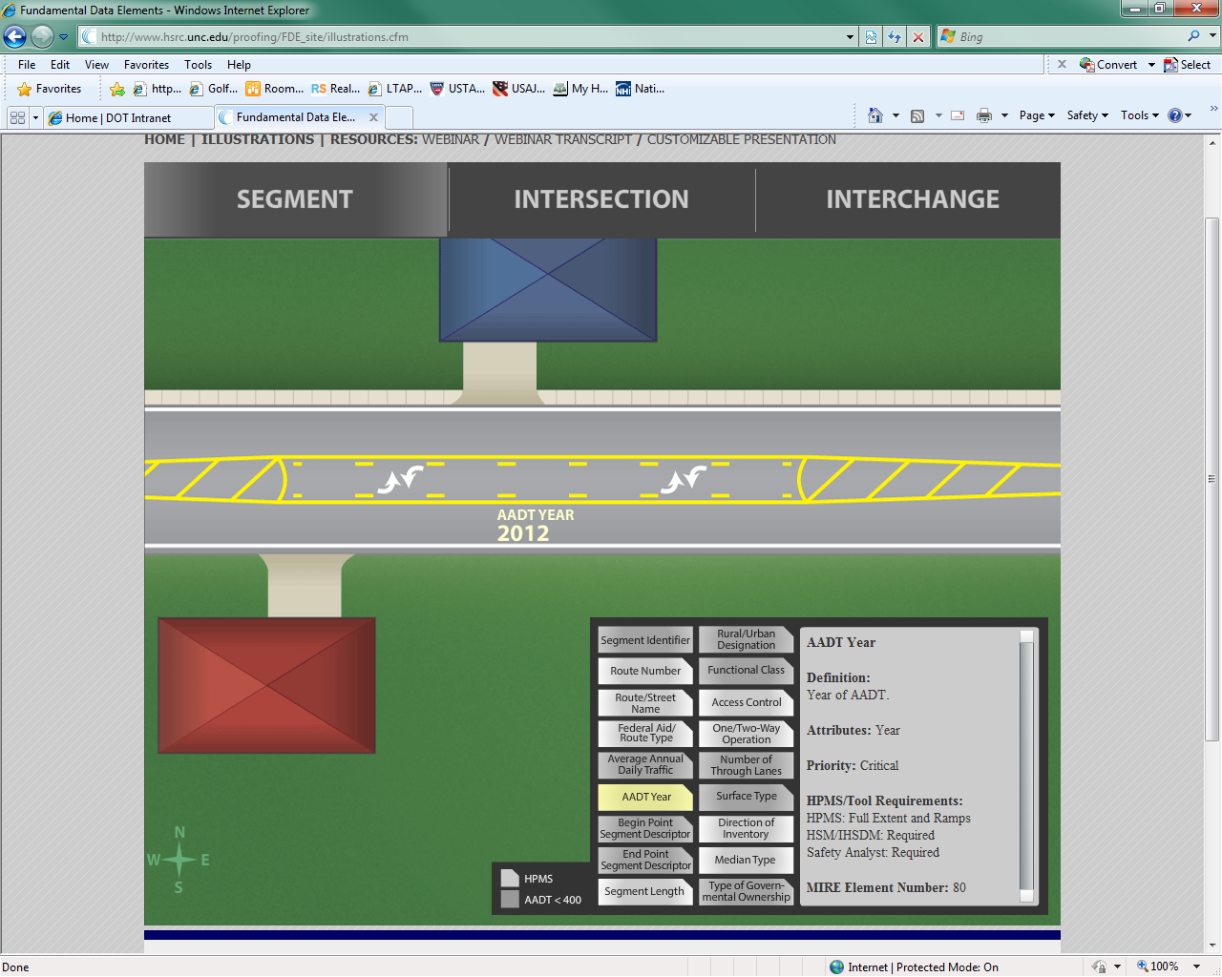
FDE Roadway Segment Data Elements

Slide 14
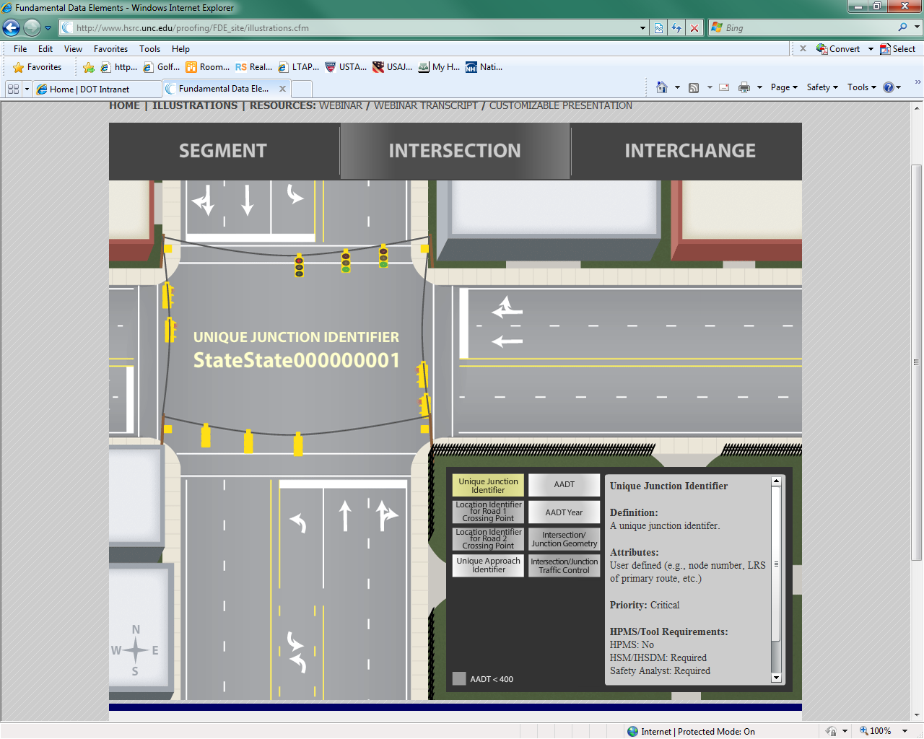
FDE Intersection Data Elements

Slide 15
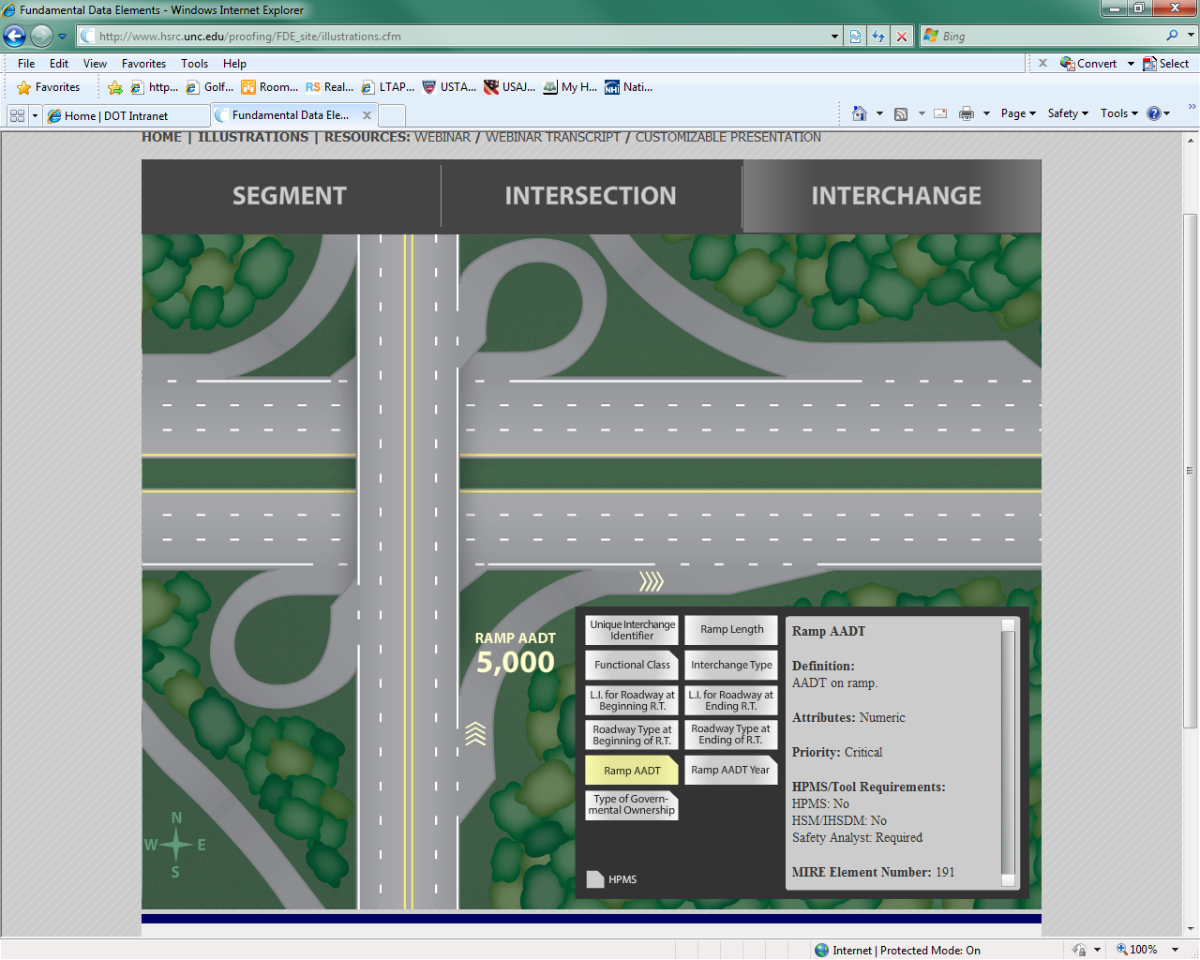
FDE Interchange Data Elements

Slide 16
MAP-21 Eligible Safety Data Collection, Analysis, and Improvement Activities
“Highway safety improvement projects are defined as strategies, activities and projects on a public road that are consistent with a State’s SHSP and correct or improve a hazardous road location or feature or address a highway safety problem.”
Collection, analysis and improvement of safety data is specifically identified as an eligible project within the definition of a HSIP

Slide 17
Complementary Processes
MAP-21 specifies that State efforts to advance their capabilities for safety data collection, analysis and integration be conducted in a manner complements the Highway Safety Plan (NHTSA) and the Commercial Vehicle Safety Plan (FMCSA).
The State TRCC
The State’s Traffic Records Strategic Plan
  MIRE FDE Implementation Plan
Notes:
The State TRCC provides a forum through which the traffic records processes of these diverse safety programs (HSIP, HSP, CVSP) may be vetted and coordinated.
The State’s Traffic Records Strategic Plan (which is necessary for State’s to qualify for NHTSA’s Section 405 grants) provides a document to identify traffic records program activities under the three Fed programs and assure complementary and coordinated activities

Slide 18
Implications for State and Local Govt
Better communications between State and Local Government agencies
Closer examination of data needs
Coordination on measures to share data
  Data transfers
  Data integration
FHWA support
  RDIP
  RDETAP

Slide 19
State Safety Data Guidance Links
Guidance on State Safety Data Systems
  http://www.fhwa.dot.gov/map21/guidance/guidesafetydata.cfm
Question & Answer on State Safety Data Systems
  http://www.fhwa.dot.gov/map21/qandas/qassds.cfm

Slide 20
Contact Information
Robert Pollack
FHWA Office of Safety
Robert.pollack@dot.gov
202-366-5019

