Slide 1
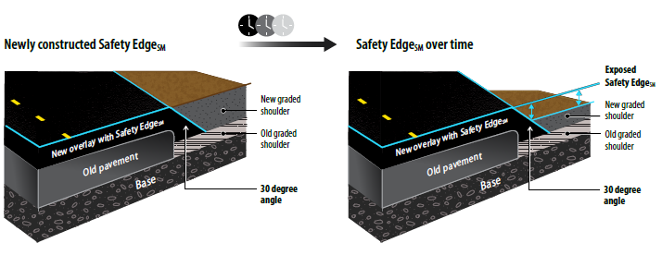
Safety Edge on Local System
Shoe Loaner Program Update or Expansion
Rewrite Design and Construction Guide and/or Brochures for Locals
Website Updates – what is needed?

