Slide 1
HSIP Sign projects: Indiana’s experience
Laura Slusher, PE Indiana LTAP

Slide 2
Indiana Sign Projects
Local agencies outside of an MPO area apply through LTAP, who acts as a gatekeeper to facilitate the process and help reduce errors in applications
Application assistance is provided to local agencies through LTAP
Local agencies can prepare own application, hire a consultant or use LTAP

Slide 3
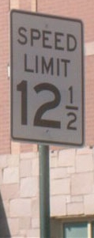
Indiana Sign Projects
Two types of projects
  Sign Inventory
  ($50,000 maximum)
  Sign Replacement
  ($100,000 maximum)
Some equipment
purchases allowed

Slide 4
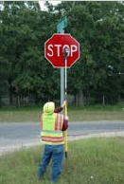
Indiana Sign Projects
Inventory projects
Funds agency to gather data on all their signs
Eligible costs - labor, software, equipment
Simple “short form” application

Slide 5
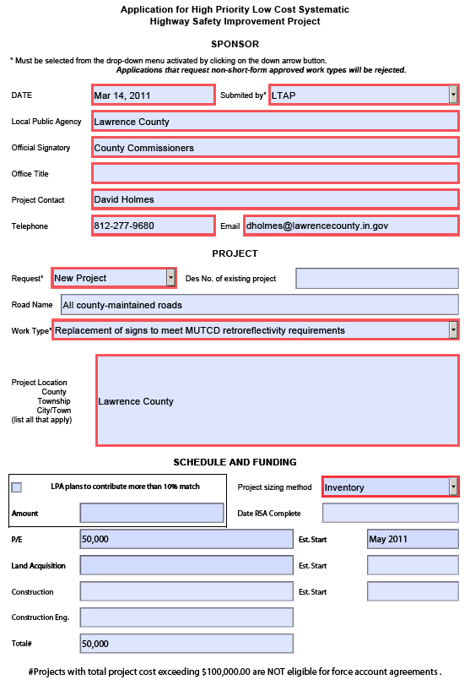
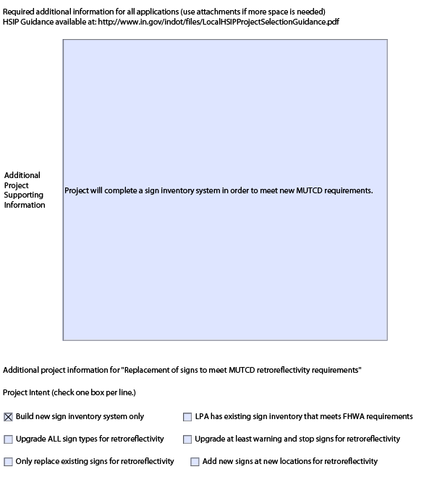

Slide 6
Indiana Sign Projects
Replacement Projects
Eligible expenses - signs, sign posts, mounting hardware, labor, installation equipment
Does not fund inventory
Requires needs analysis
  Demonstrates the need for the project through presentation of crash data, benefit/cost ratio and proof of deficient signs

Slide 7
Indiana Sign Projects
Replacement Projects
Allowable project cost based on number of crashes
  Most small towns not eligible
Benefit/Cost Ratio
  Should be 2.0 or higher
  6-year life cycle for sign projects
Crash Reduction Factors
  15% for Fatal & Injury crashes
  7% for Property Damage Only (PDO) crashes

Slide 8
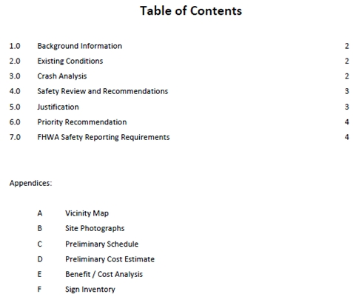

Slide 9
Indiana Sign Projects
Applications must include:
  Cover letter signed by governing board (County Commissioners, City/Town Council)
  Commitment to provide the 10% match and maintain the improvements
  Short Form (Inventory Projects) or Needs Analysis (Replacement Projects)
  Preliminary project schedule
  Projected cost estimate

Slide 10
Significant increase in HSIP applications
 | Road Rehab Projects | Sign Projects |  | % Funded |  | Project Costs (millions) |  | Federal Aid Requested (millions)
2010
Spring | 1 | 4 |  | 100% |  | $2.1 |  | $1.9
Fall | 2 | 16 |  | 100% |  | $6.0 |  | $5.4
2011
Spring | 1 | 71 |  | 63% |  | $4.6 |  | $4.1
Fall | No Call for Projects
2012
Spring | No Call for Projects
Fall

Slide 11
Indiana Sign Projects
Frequently Asked Questions
  Can the agency use their own forces?
  When is the 10% match required?
  What is required in the sign inventory?
  Are equipment purchases allowed?
  Is proof of right-of-way required?
  Are Davis-Bacon wages required?
  Is an environmental document required?

Slide 12
Lessons Learned
Don’t lose sight of the goal of the HSIP
Use this as an opportunity to add needed warning signs at potentially-hazardous locations
Consider allocating a certain amount per project type (e.g. road rehab, sign projects, hot spot, systemic, etc.)
Consider a small-town sign program for those not eligible for HSIP

Slide 13
Tennessee Sign Grant Program
TDOT Sign Grant Program, established in 1983, has assisted towns and cities (population<5000) and counties (population<30,000) to install signs
Any regulatory or warning sign on locally-maintained streets is eligible
TDOT funds signs, posts, and mounting hardware – recipients provide all installation labor as their match to the grant

Slide 14




Iowa Small Town Sign Program
http://www.iowadot.gov/traffic/smalltownsign.htm
Allows communities to replace damaged, obsolete or substandard signs and signposts
Provides up to $5,000 of signs and signposts per applying community on a first-come, first-served basis
Limited to these signs:

Slide 15
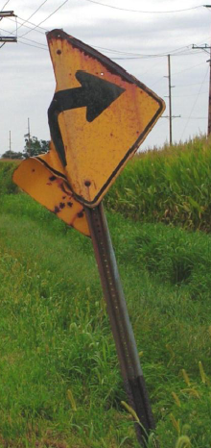
Benefits of Sign Projects
Increases safety through more visible signs
Brings everything up to standard
Encourages accountability for future maintenance of signs
Establishes an inventory
Establishes sign assessment and management methods
Reiterates signs are an important asset
Photo Courtesy of The Scheider Corporation

Slide 16
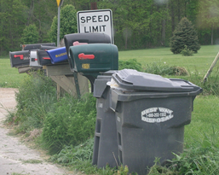
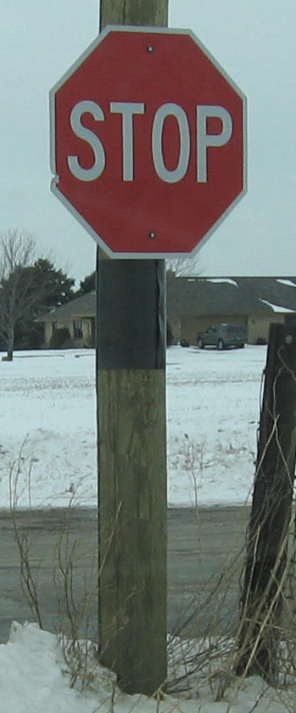
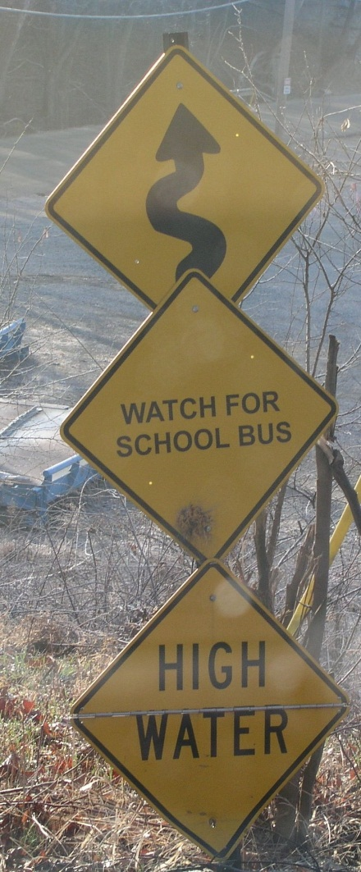
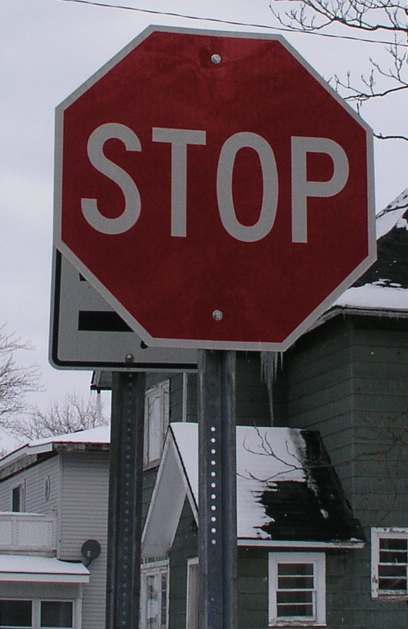
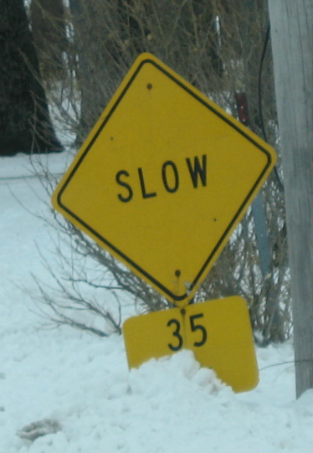
Benefits of Sign Projects

Slide 17
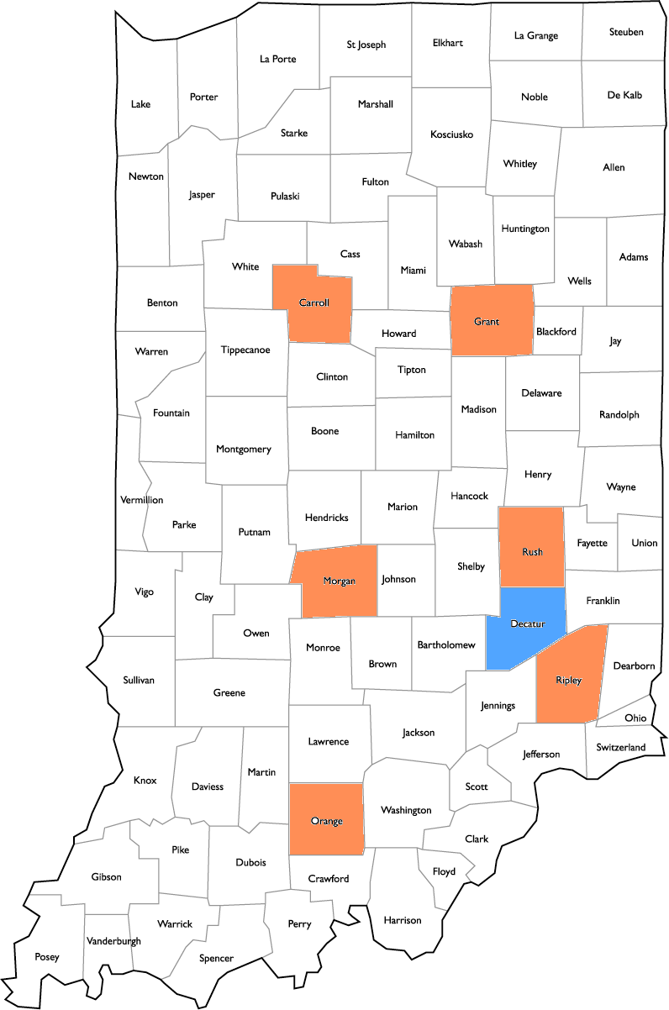
Sign Project Evaluation
Evaluated a countywide sign replacement in Decatur County, IN
Before & After Study with a Comparison Group

Slide 18
Sign Project Evaluation
7% reduction in overall crashes
Corresponds well to the CRFs being used
Total Crashes | Before (crashes/yr) | After (crashes/yr)
Decatur County | 191 | 172

Slide 19
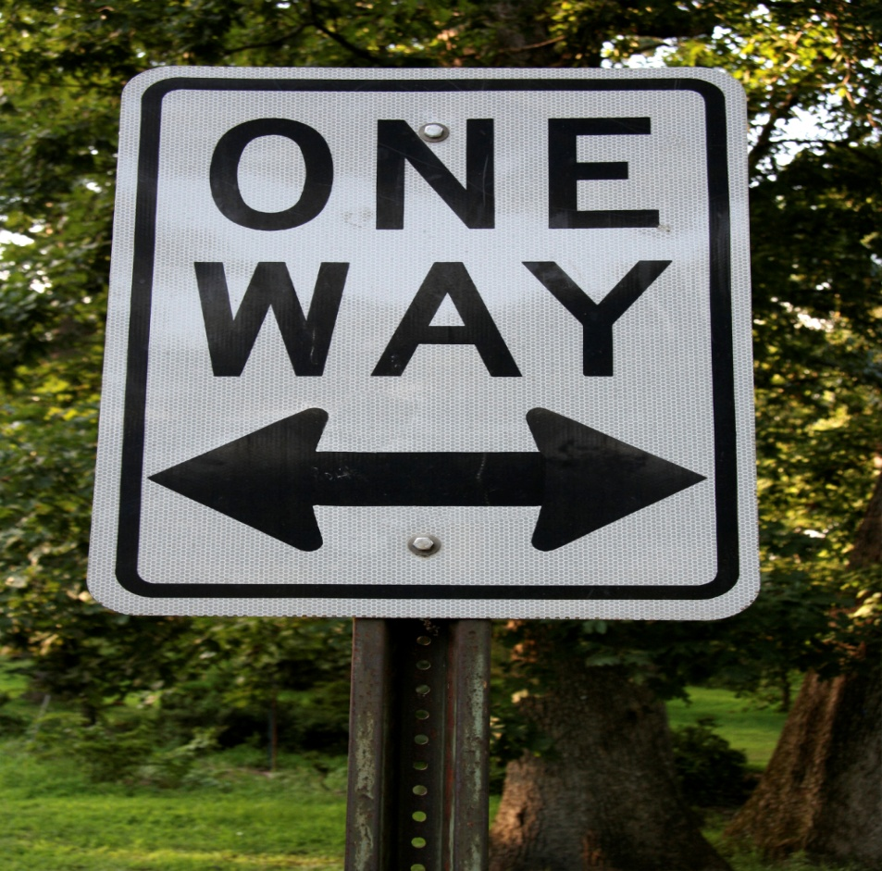
Questions?
Laura Slusher
Indiana LTAP
lslusher@purdue.edu
765-494-7038

