Slide 1

Using a Valuable Tool –
Training Resource Syntheses
Matheu Carter, Delaware T² Center
David Orr, Cornell Local Roads Program (NY LTAP)

Slide 2
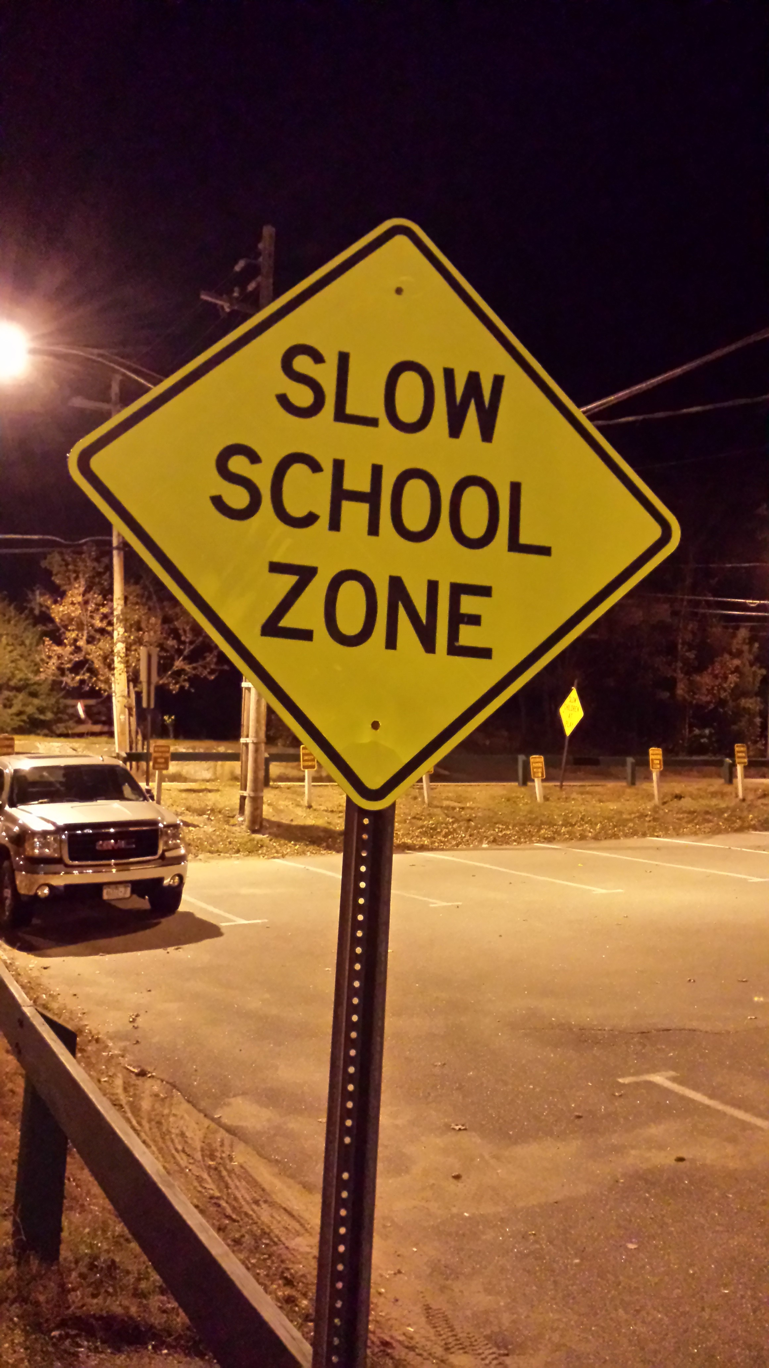
Training Resource Syntheses
Winter Maintenance
Pavement Preservation
Highway Safety Manual
Work Zone
Asset Management
Pavement Wearing Courses

Slide 3
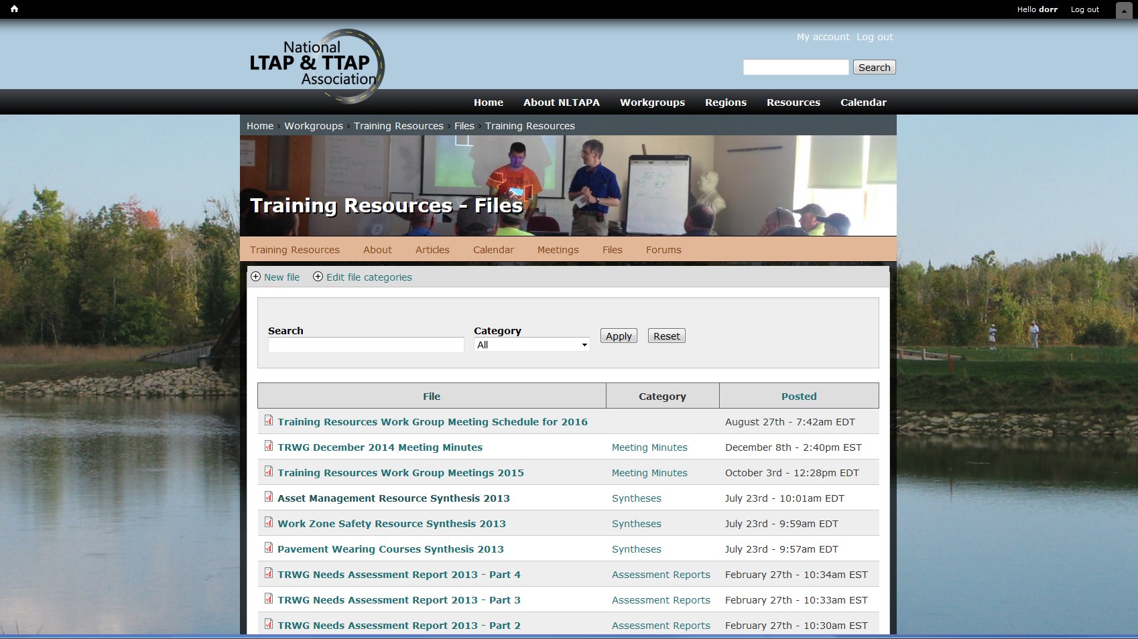
nltapa.org
Workgroups
Training Resources
Files

Slide 4

Who Can Use a Resource Syntheses?
New workshop
Add to/ update existing training materials
Learning about changes
Developing a new presentation
Answering a technical assistance question
Finding existing training materials or options

Slide 5
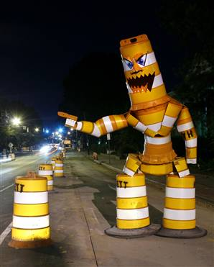
Information Available
Name of Resource
Resource Type
Duration
Audience
Difficulty Level
Description
Cost
Contact

Slide 6
Pavement Preservation
National Center for Pavement Preservation
Foundation for Pavement Preservation (FP2)
Asphalt Recycling & Reclaiming Association
International Slurry Surfacing Association
Asphalt Emulsion Manufacturers Association
American Concrete Pavement Association
National Highway Institute (NHI)
FHWA
Notes:
Go to the CLRP webpage to show alternatives

Slide 7
Pavement Preservation
MN LTAP
OH LTAP
Cornell Local Roads Program
Delaware T2 Center
Notes:
Go to the CLRP webpage to show alternatives

Slide 8
Winter Maintenance
NLTAPA Resource Database,
National Highway Institute
American Public Works Association
Transportation Research Board
Salt Institute
AASHTO
FHWA

Slide 9
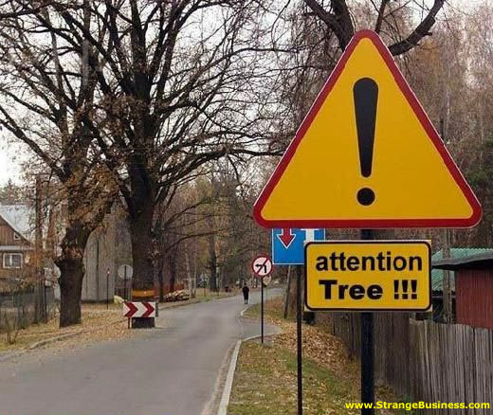
You Can Help!
Use
Help fill holes
Share new materials
Develop a new topic

Slide 10
Thank You
Matheu Carter, matheu@udel.edu
David Orr, david.orr@cornell.edu

