Slide 1


Slide 2

29 County Presentations
March through May

Slide 3
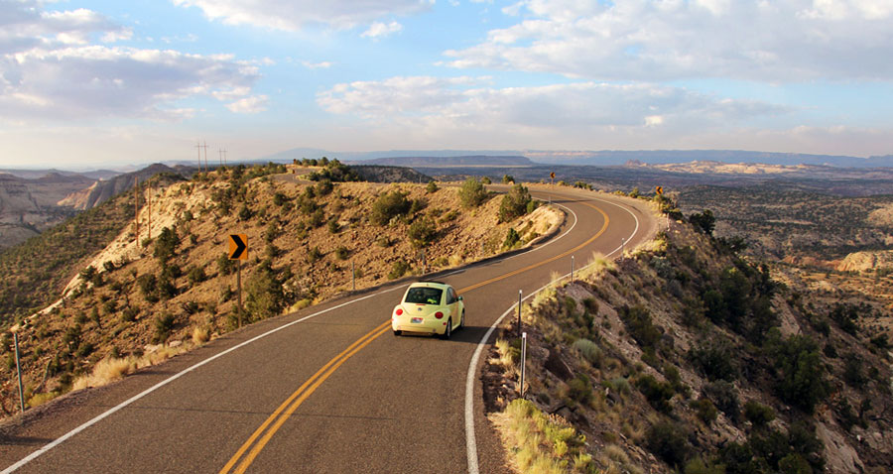
Asphalt Conference

Slide 4
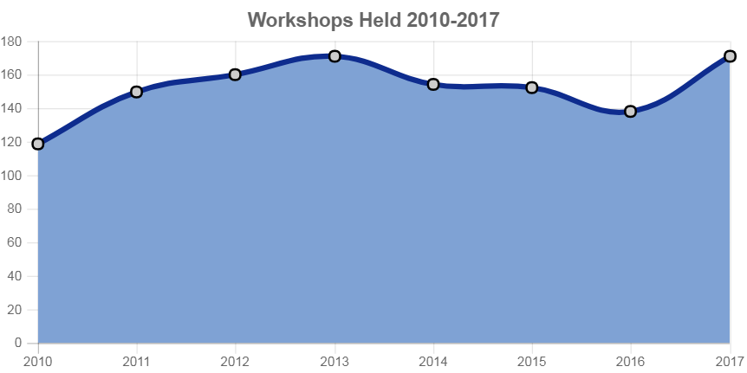

Slide 5
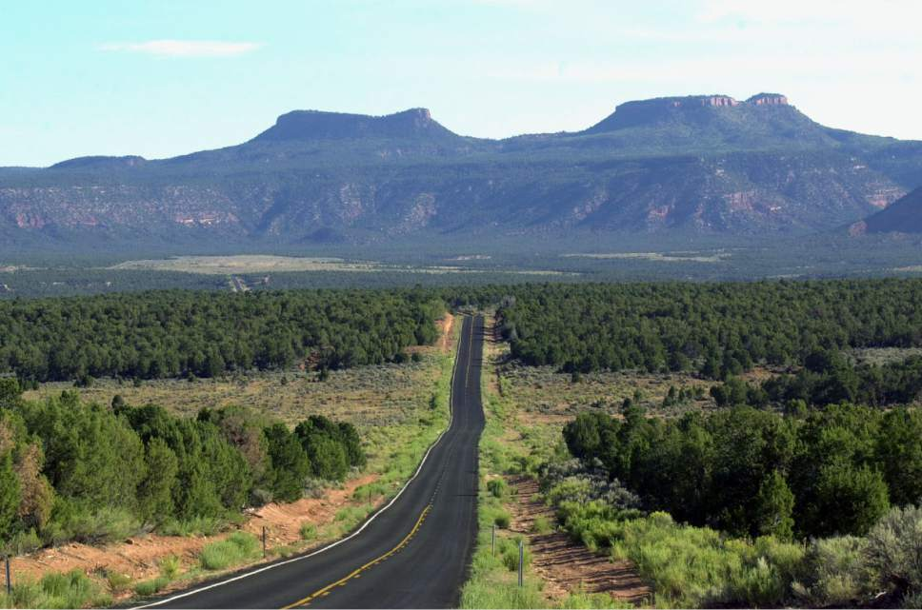
Technical Assistance
Pavement Evaluations
Sign Retro Evaluations
RSA’s at Fatal Locations
Traffic Counts
Speed Studies

Slide 6

APWA Conference

Slide 7

UDOT Engineers Conference

Slide 8
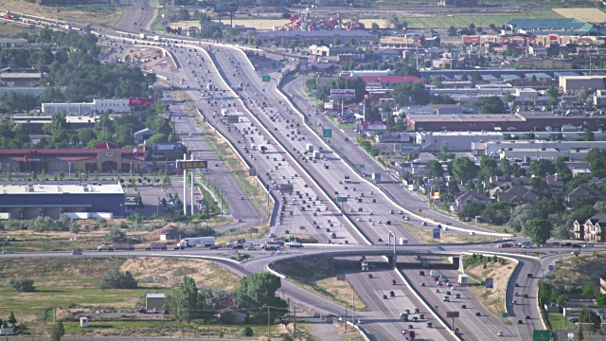
Utah City Engineer Conference

Slide 9
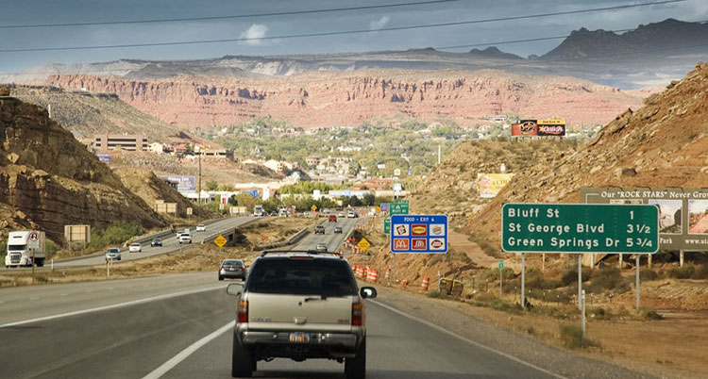
JOINT HIGHWAY COMMITTEE

Slide 10



