Slide 1

North Central Region Annual Meeting LTAP
May 22, 2018
Estes Park, CO

Slide 2
Introduction – WY T²/LTAP Center
The Wyoming T²/LTAP Center
Safety Studies
Traffic Studies
WRRSP
WRIRSP
Sign Program
Traffic Volumes Prediction
Speed Limits
MUTCD
Asset Management
Paved Roads
Unpaved Roads
Culverts
Notes:
Oil and Gas Project/Presentation 9-27-2012/Condition Charts v2.xlsx

Slide 3
Introduction – WY T²/LTAP Center
The Wyoming T²/LTAP Center
Loan Program
Training
Retro
Reflectometer
Dust Monitors
Traffic Counters
Certification
Workshops
Notes:
Oil and Gas Project/Presentation 9-27-2012/Condition Charts v2.xlsx

Slide 4
Certifications and Workshops
Around 30 training and certification sessions every year.
Some in Laramie but most training sessions are scattered around the state.
Three Certification programs which are required for job performance.
Roads Scholars

Slide 5
Certifications
LPA
ATTSA Work Zone and Flagger Certification
WYDOT Certification
  Asphalt
  Aggregate
  Concrete

Slide 6
Workshops
Selecting and Applying Asphalt Pavement Maintenance Treatments
Chip-Seal and Micro Surfacing
Low Cost Safety Improvements
Building a Successful Concrete Project
Gravel Roads
Transportation and Safety Congress
OSHA

Slide 7
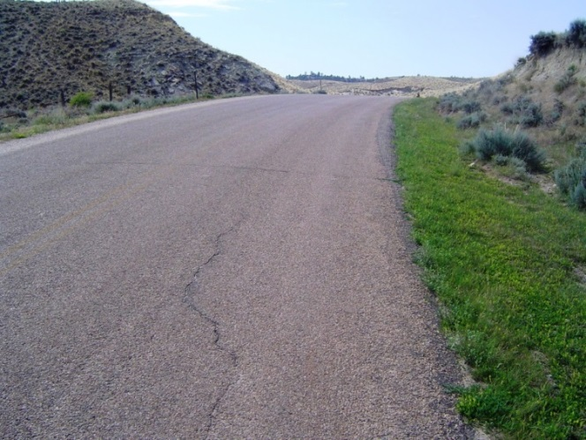
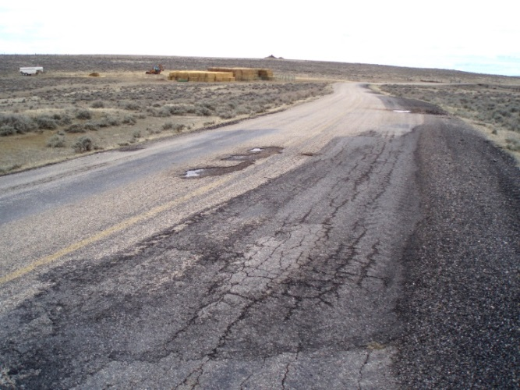
Progress in Developing PMS for Managing County Paved Roads

Slide 8
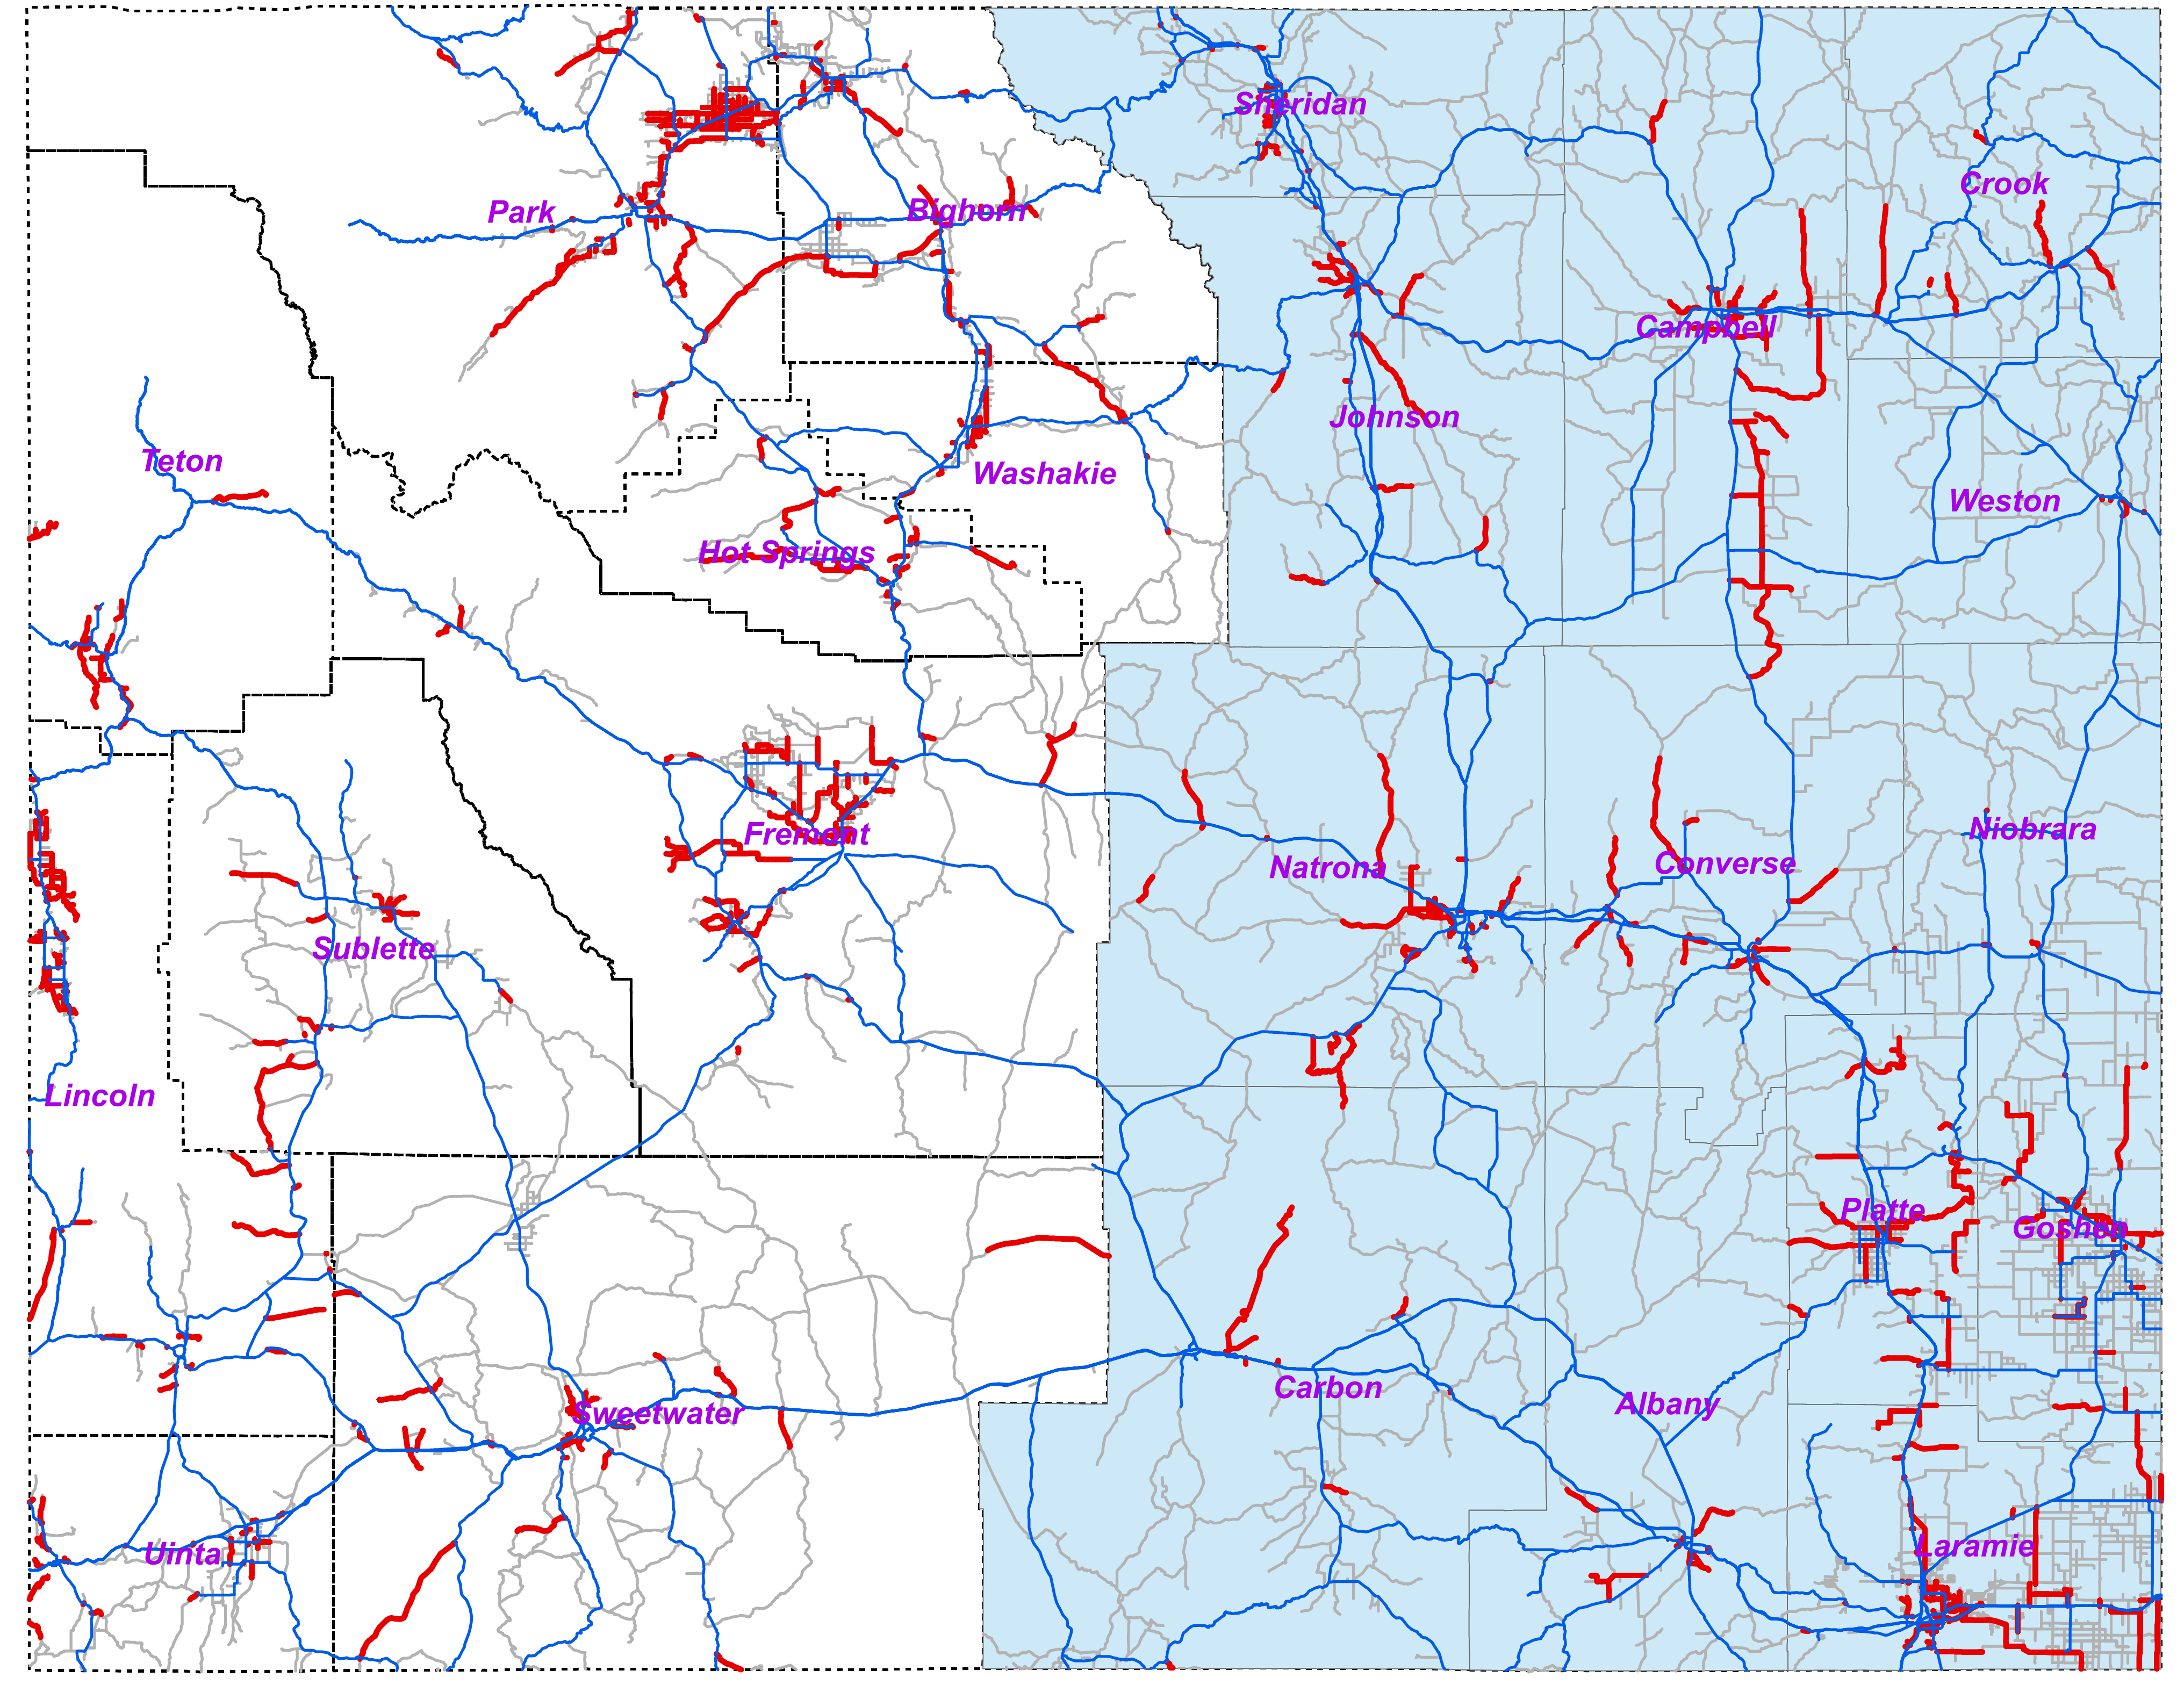
County Paved Roads
Total Length: 2,423 miles
Total Number of Segments: 2,030
Minimum Length: 52.8 ft.
Maximum Length: 25.8 miles
County | East |  | West
 | Segments | Mileage | Segments | Mileage
Big Horn |  |  | 106 | 110
Fremont |  |  | 177 | 222
Hot Springs |  |  | 32 | 77
Lincoln |  |  | 210 | 179
Park |  |  | 315 | 265
Sublette |  |  | 59 | 72
Sweetwater |  |  | 149 | 154
Teton |  |  | 58 | 66
Uinta |  |  | 61 | 42
Washakie |  |  | 57 | 44
Albany | 38 | 43
Campbell | 79 | 182
Carbon | 17 | 53
Converse | 49 | 90
Crook | 21 | 40
Goshen | 116 | 118
Johnson | 48 | 100
Laramie | 174 | 245
Natrona | 107 | 135
Niobrara | 4 | 3.3
Platte | 102 | 158
Sheridan | 43 | 22
Weston | 8 | 5
Total | 806 | 1,194 | 1,224 | 1,229

Slide 9
What is the project about?
Most asphalt county roads were built several decades ago.
Oil and gas drilling generate heavy traffic.
Large economic loss to society.
Provide comprehensive database that will allow appropriate measures to prevent large economic loss.

Slide 10
Objectives
Document current conditions.
  Enable counties to determine impacts of industrial or other activities using paved county roads.
  Compare to state highways
Project future conditions.
Establish maintenance, repair, rehabilitation and reconstruction strategies.

Slide 11
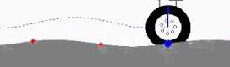
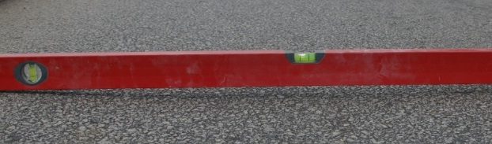
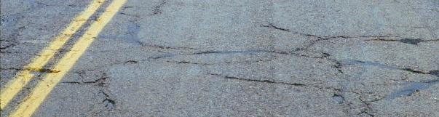
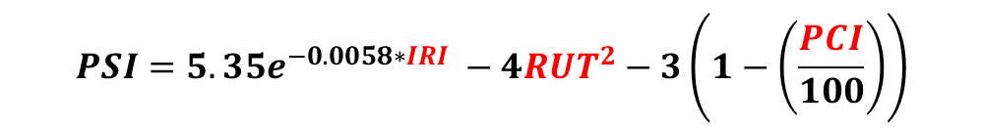
Road Condition Parameters
  International roughness index (IRI)
  Rutting
  Pavement condition index (PCI)
  Pavement serviceability index (PSI)
  Pavement thicknesses
IRI
Rut
PCI
$$PSI=5.35e^{−0.0058∗IRI} −4RUT^{2}−3\left(1−\left(\frac{PCI}{100}\right)\right)$$

Slide 12
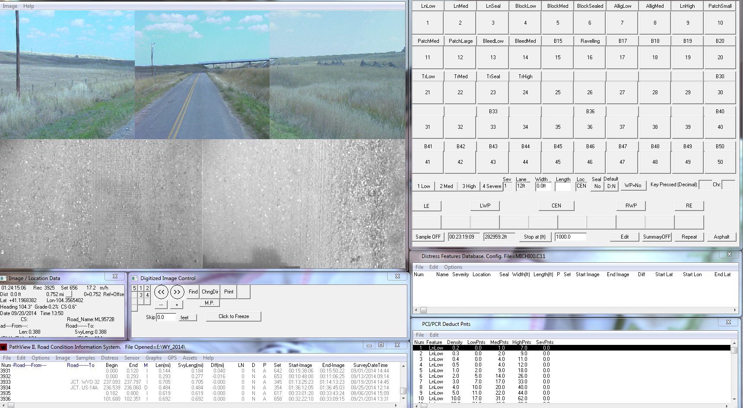
How to Calculate PCI?
Video Logs

Slide 13
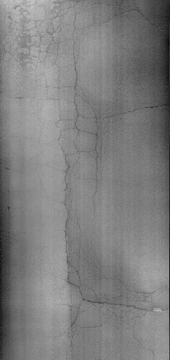
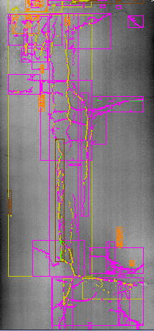
How to Calculate PCI?
Pavement Surface
Until 2015
Since 2016
Identify distresses manually
Identify distresses automatically
Manual crack detection
Automatic crack estimation

Slide 14



Slide 15
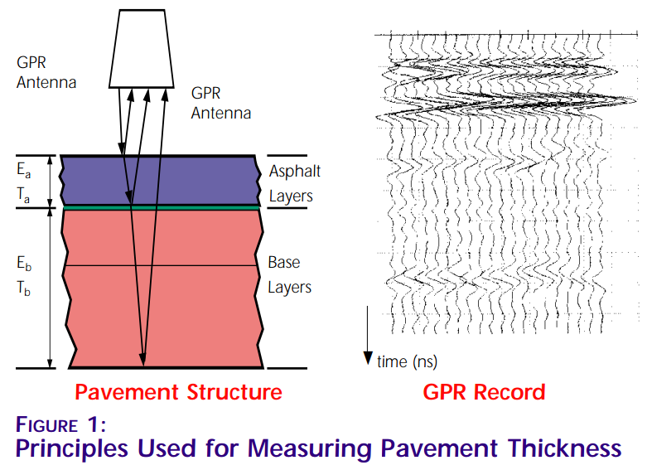
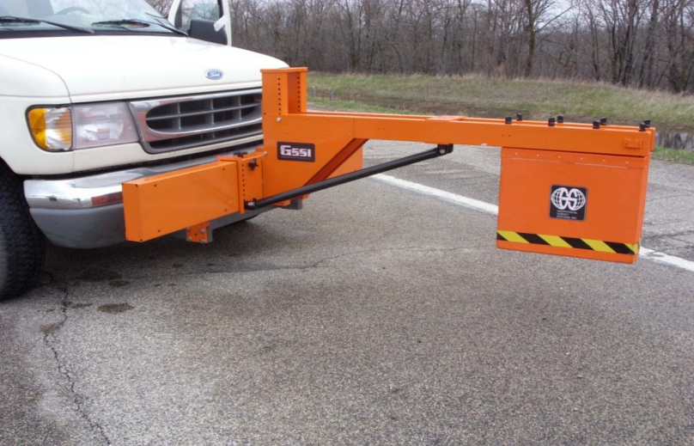
Ground Penetrating Radar (GPR)
Assessment of asphalt and base thicknesses.
  Essential for design and for durability analyses.
Conducted by a specialized van at highway speeds.

Slide 16

Data Collection
Testing completed for
  2014 (Completed)
  2015 (Completed)
  2016 (Completed)
  2017 Completed)
  Pathway Services will do the Eastern Side again in the summer of 2018.

Slide 17
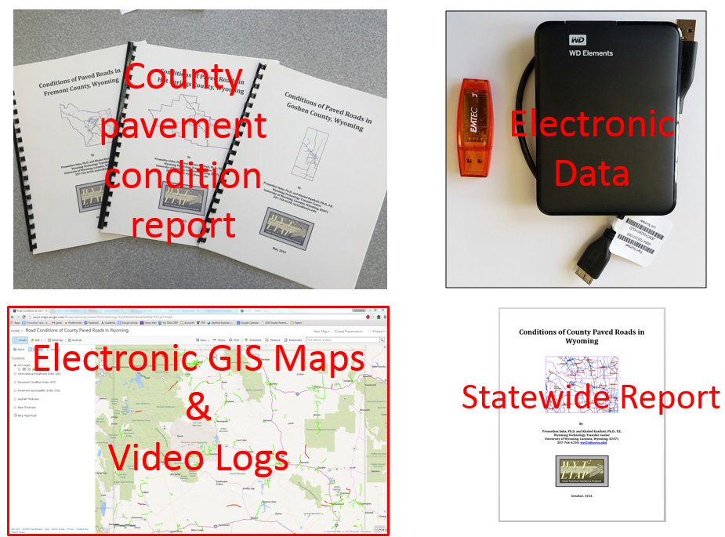
2016 Project Deliverables

Slide 18
Estimating Average Daily Traffic (ADT)
Incorporating Tourism Data in Traffic Estimation on Wyoming Low-Volume Roads

Slide 19
Overview
In the previous phases of the study, person trips, crop freight trips, and oil freight trips were included in the travel demand model for estimating ADT on Wyoming low-volume roads.
The study recommends future research to include tourism activities in the model to improve the model prediction accuracy.

Slide 20
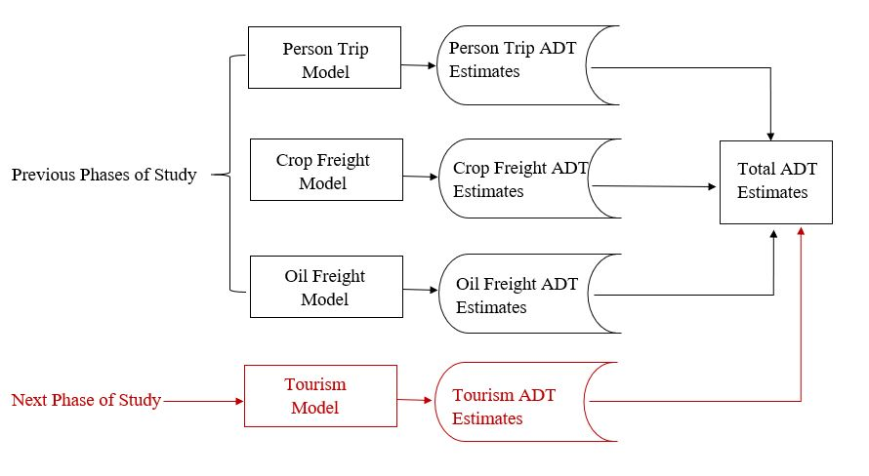
Model Development

Slide 21
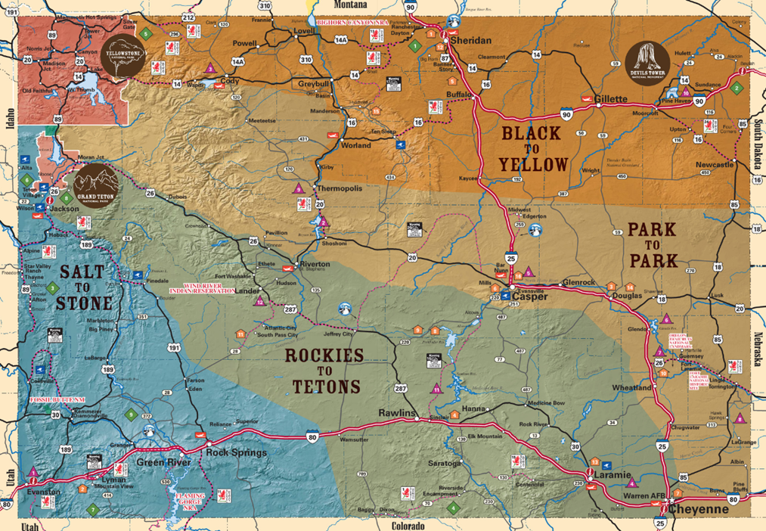
Tourism in Wyoming
Wyoming road trip itineraries
Source: TravelWyoming.com

Slide 22
Tourism-Related Parameters
traffic counts at national/state park entrances
number of camp sites in national/state park
park areas
number of hotel rooms

Slide 23
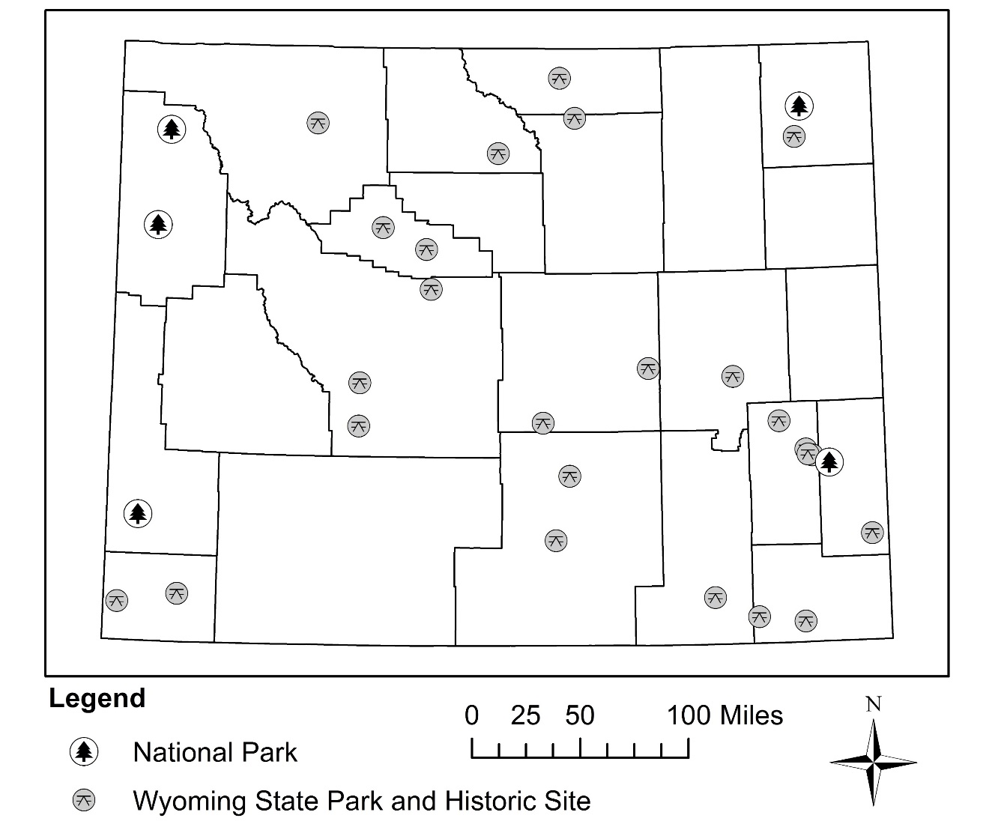
Incorporating Tourism in Travel Demand Model
Use traffic counts at national/state park entrances as model inputs.

Slide 24
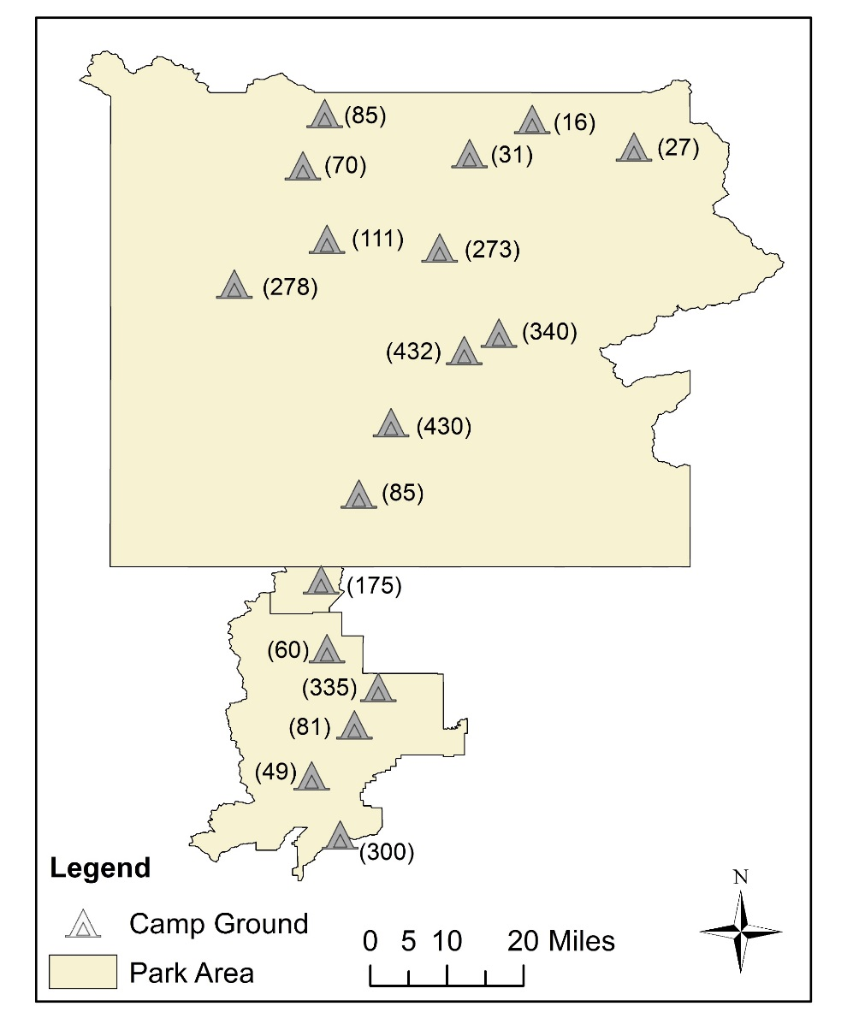
Incorporating Tourism in Travel Demand Model
Use number of camp sites in national/state parks as model inputs.
Map of Camp Ground in Yellowstone and
Grand Teton National Parks

Slide 25
Objectives
Develop a four-step travel demand model to estimate traffic on low-volume roads near the tourism destinations in Wyoming.
Identify primary predictors/trip generators of traffic.
Forecast tourism travels and their impact on transportation system.

Slide 26

Wyoming Rural Safety Program (WRRSP)
The purpose is to achieve a significant reduction in traffic fatalities and incapacitating injuries on rural roads
Notes:
Oil and Gas Project/Presentation 9-27-2012/Condition Charts v2.xlsx

Slide 27
Wyoming Rural Safety Program (WRRSP)
5 step program
  Step 1 – Crash data analysis
  Step 2 – A level 1 field evaluation
  Step 3 – Ranking system to identify high risk locations
  Step 4 – A level 2 field evaluation
  Step 5 – A benefit cost analysis
Notes:
Oil and Gas Project/Presentation 9-27-2012/Condition Charts v2.xlsx

Slide 28
Low Cost Safety Improvements
Delineators
Shoulder Improvement
Pavement Striping
Advance Warning Signs
Edge Rumble Strips
Culvert Extensions
Guard Rail
Cattleguard Extensions

Slide 29
WRRSP
Notes:
Oil and Gas Project/Presentation 9-27-2012/Condition Charts v2.xlsx

Slide 30
Road Sign Program
Counties identify signs needed for each road that is on a list the T² Center has compiled of high crash locations for every County in the state,
Then submit a RSP request form to the T² Center.
All signs and post were provided to the Counties at no cost. The counties were required to install them.
Notes:
Oil and Gas Project/Presentation 9-27-2012/Condition Charts v2.xlsx

Slide 31
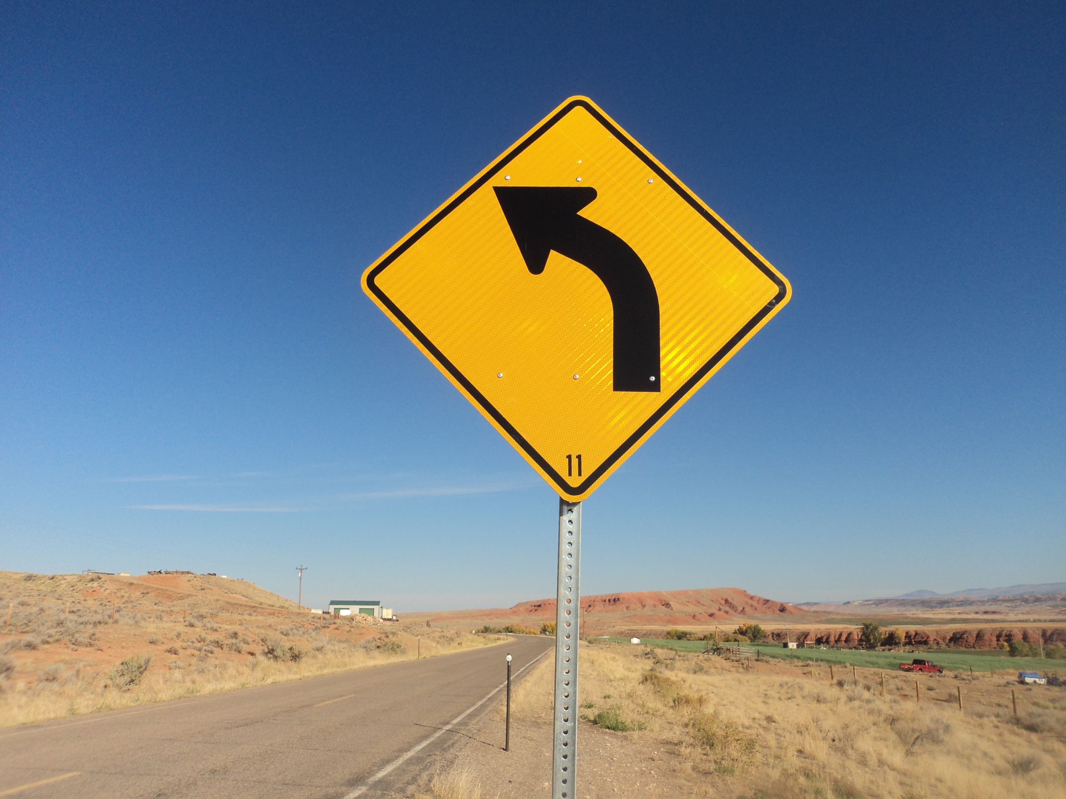
Road Sign Program - Steps
Step 1 – Identified high crash locations.
Step 2 – Counties identify signs.
Step 3 – Submit request
Step 4 – WYDOT purchases signs and ship to counties.
Step 5 - Installation of signs
Step 6 – Wyoming LTAP Center inspects projects
Notes:
Oil and Gas Project/Presentation 9-27-2012/Condition Charts v2.xlsx

Slide 32
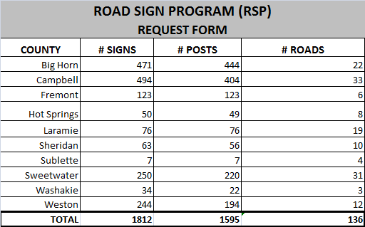
Road Sign Program Round 1
Notes:
Oil and Gas Project/Presentation 9-27-2012/Condition Charts v2.xlsx

Slide 33
Road Sign Program Round 2
Notes:
Oil and Gas Project/Presentation 9-27-2012/Condition Charts v2.xlsx

Slide 34
Road Sign Program Round 3
ROAD SIGN PROGRAM (RSP) 2017 ROUND # 3
REQUEST FORM
COUNTY | CONTACT PERSON | Total Signs | W 12' | W 14' | M 12' | M14'
Campbell | Kevin Geis 682-4411 | 104 |  | 53 |  | 10
Hot Springs | DaveSchlager 351-0142 | 23 |  | 23
Laramie | Justin Arnold 633-4695 | 521 | 3 |  | 42
Lincoln | Amy Buttler 877-2104 | 229 |  | 33 |  | 164
Natrona | Susan Phillips 235-9311 | 178 | 6
Sheridan | Ken Muller 674-2920 | 43 | 24 | 20
Teton | Dave Gustafson 733-7190 | 200 |  |  | 5 | 1
 | TOTALS | 1298 | 33 | 129 | 47 | 175

Slide 35
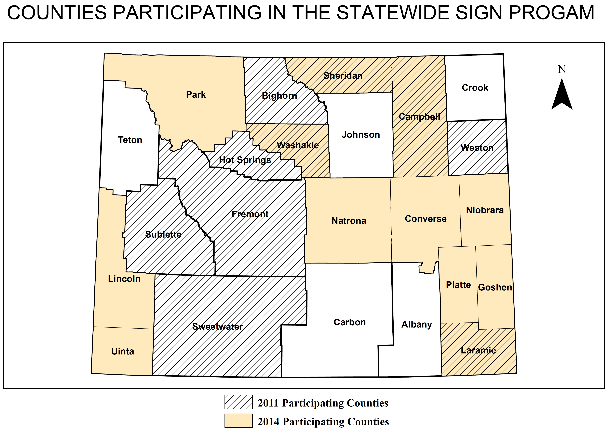
Road Sign Program
Notes:
Oil and Gas Project/Presentation 9-27-2012/Condition Charts v2.xlsx

Slide 36
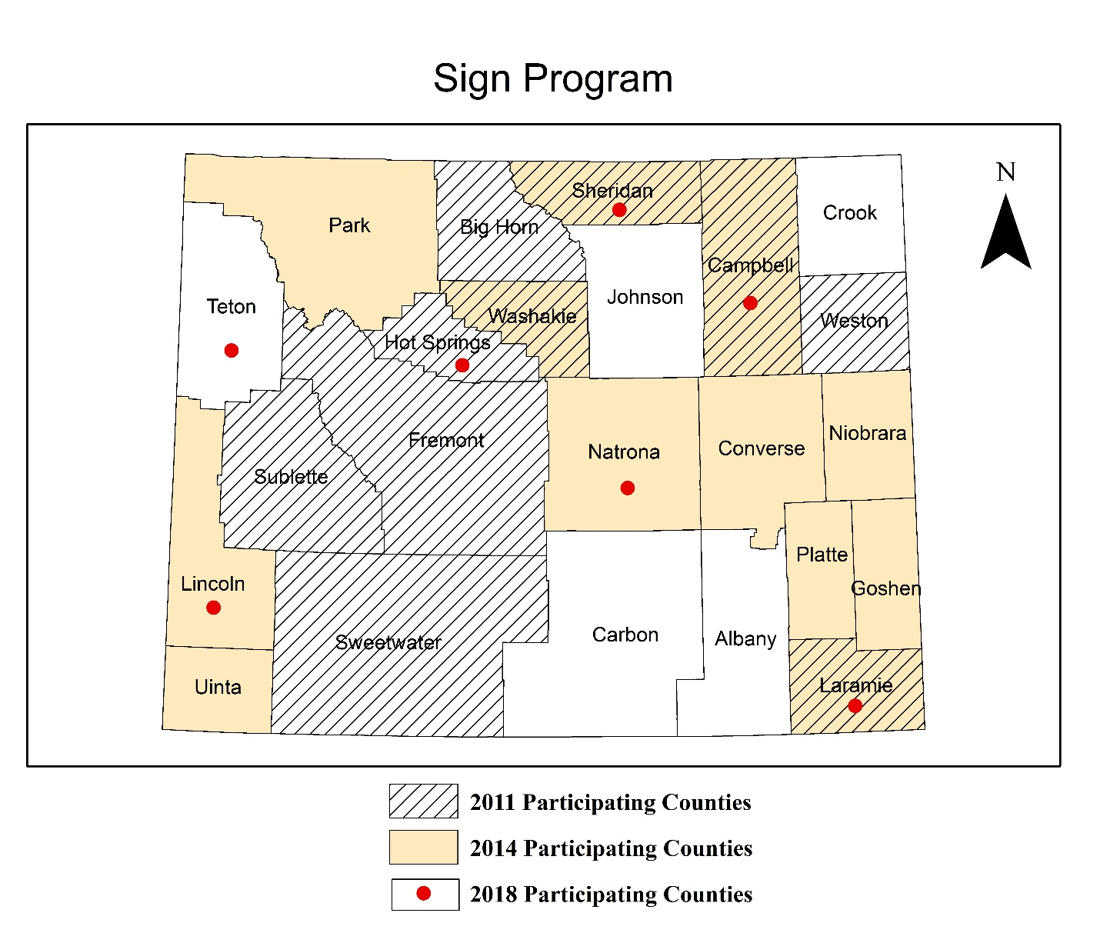
Road Sign Program

Slide 37


Slide 38


Recorded Trainings
Participation can be done two ways
Recorded Training
On Site Training, Live Video
You can participate in recorded trainings on your own at your PC
With a group of employees in a workshop format

Slide 39

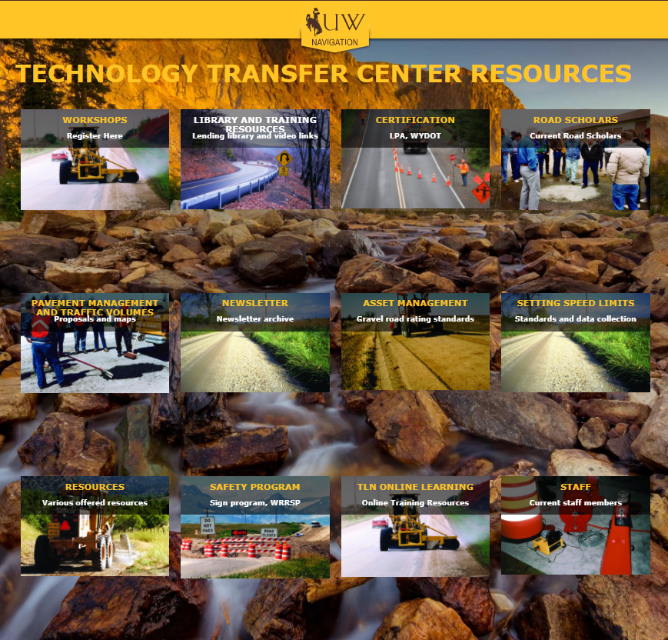
TLN

Slide 40

How to Get T2 Credit
Get supervisor signature and the fax the form to the T2 center to receive credit towards the Roads Scholars Program

Slide 41

How to Get T2 Credit
Get supervisor signature and the fax the form to the T2 center to receive credit towards the Roads Scholars Program

Slide 42
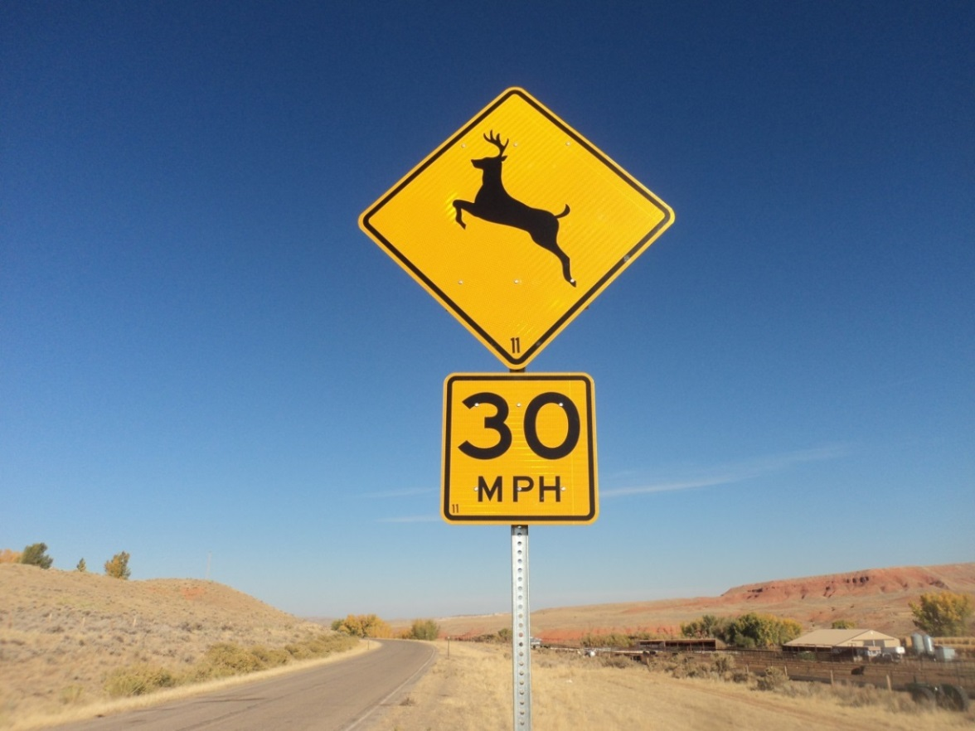

Tribal Roadway Safety Improvement Program
Methodology
Case Study
Regional Implementation
National Implementation

Slide 43
Objectives
Develop methodology to identify high risk locations on Indian Reservation roads
Improve crash reporting
Develop Tribal Strategic Highway Safety Plan
Develop Tribal livability program

Slide 44
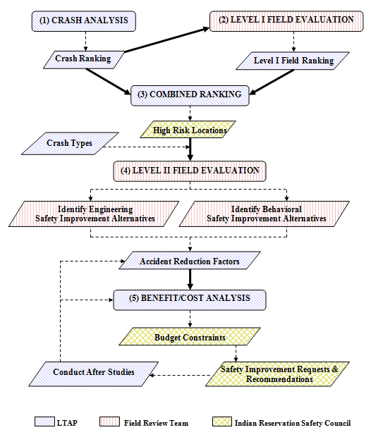
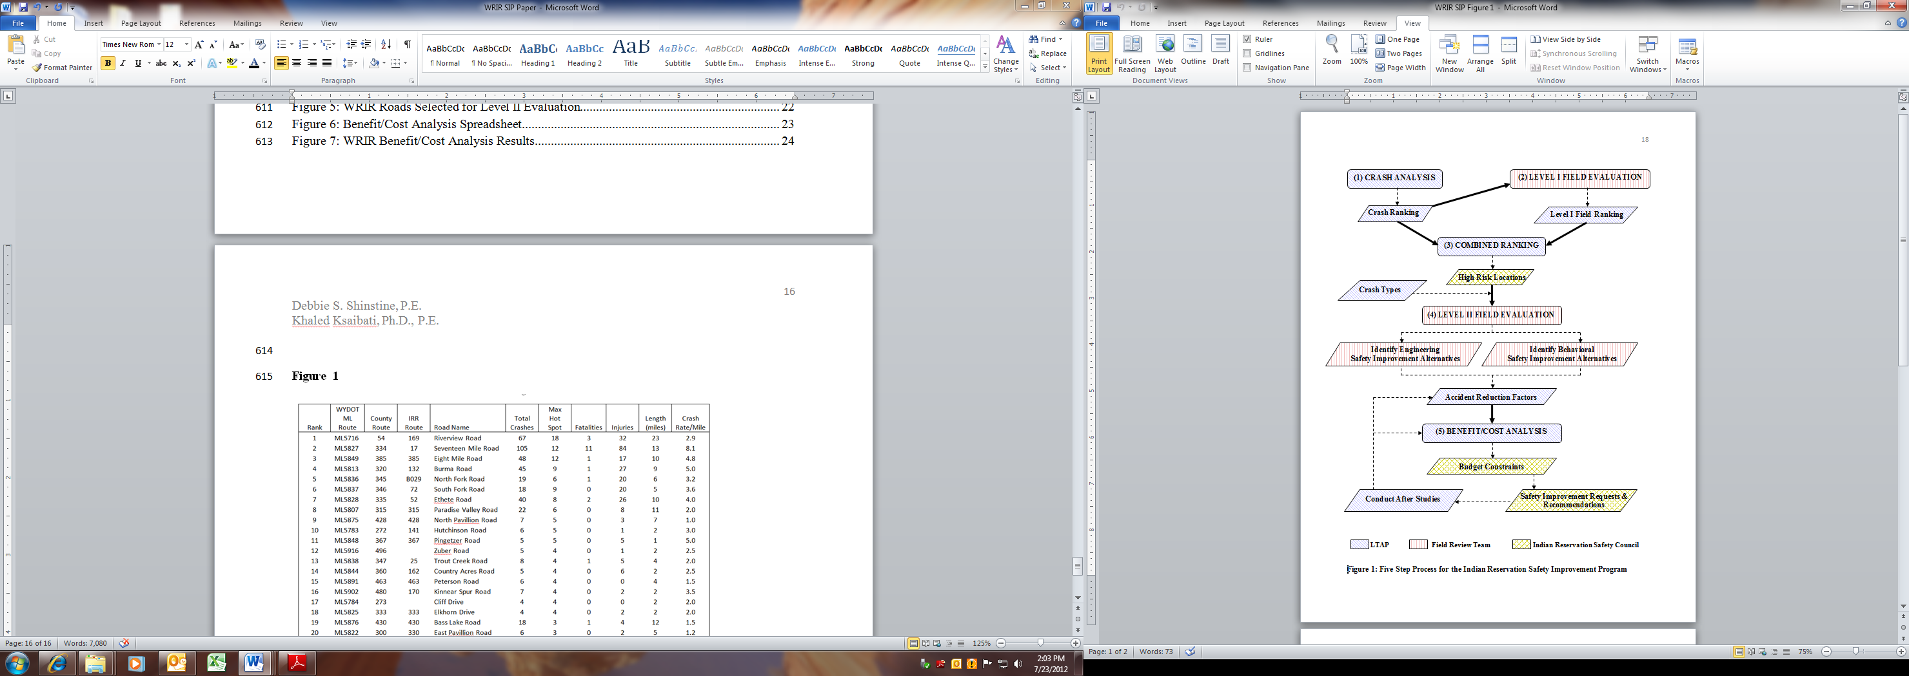
5 Step Process
Crash Data Analysis
Level I Field Evaluation
Combined Ranking
Level II Field Evaluation
Benefit Cost Analysis

Slide 45


CASE STUDIES
Background
  WYTT/LTAP & WYDOT
  High Risk Rural Roads Program
  Wyoming Rural Roads Safety Program
    Local Governments
  Develop similar methodology for Tribal Lands
    Results in Low Cost Safety Improvements

Slide 46

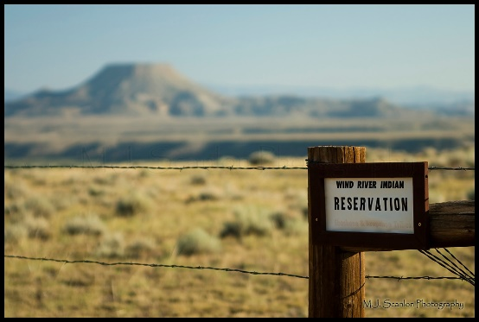
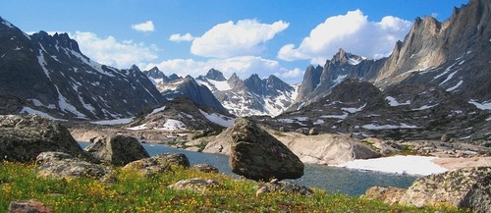
CASE STUDIES
Wind River Indian Reservation
    Northern Arapahoe & Eastern Shoshone Tribes
    2.2 Million Acres
    Total BIA Inventory of 1,227.8 miles
      Only 174.7 paved miles
    State maintains roughly 200 miles of US and state highways

Slide 47
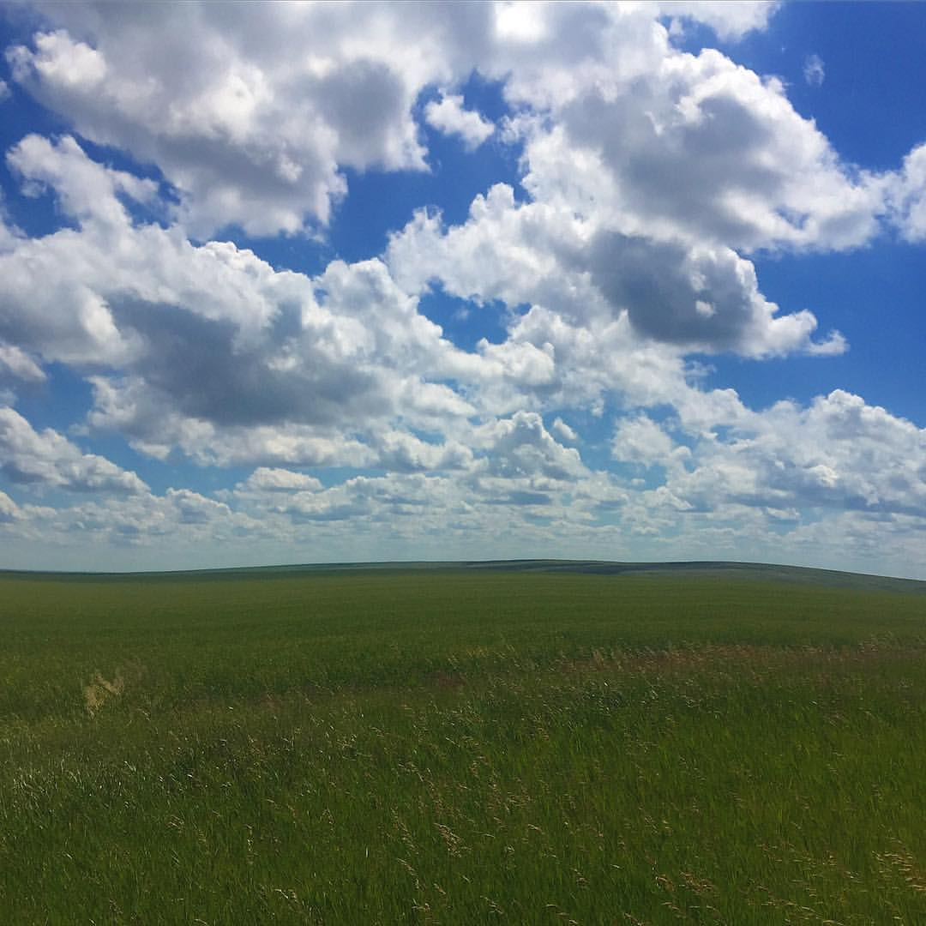

CASE STUDIES
Fort Peck Indian Reservation
    North Eastern Montana
    ~ 2 million acres
    Assiniboine and Sioux Tribal Members
      About 12,000 enrolled members
    1,500 miles of roads
      375 miles of BIA/Tribal owned roads
      Of the 211 BIA roads, over half are unpaved

Slide 48
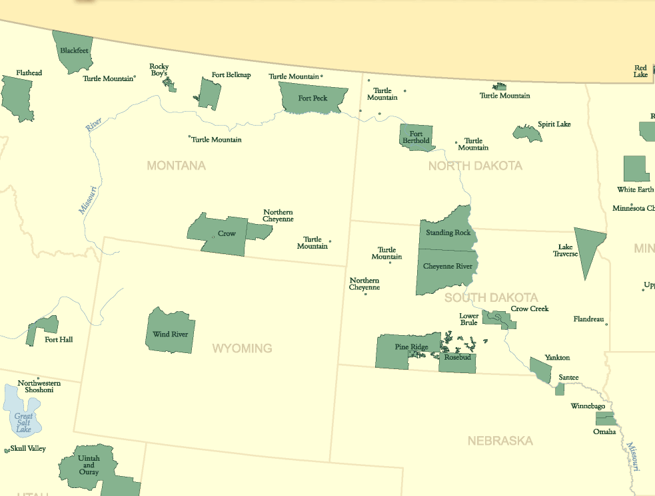







Slide 49
Speed Limit Skim Tree
County technicians are trained.
County Identifies Road
Data Collection
County hires a P.E. to do the study according to the standards.
WY T²/LTAP Center
P.E.
County Commission Resolution #
Speed Limit Posted
Notes:
Oil and Gas Project/Presentation 9-27-2012/Condition Charts v2.xlsx

Slide 50
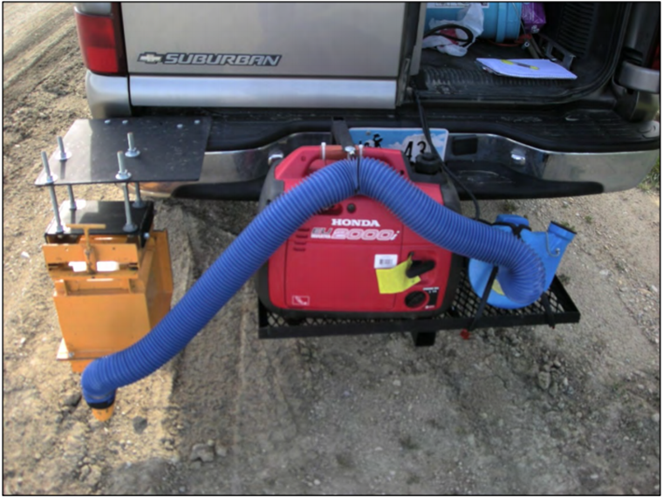
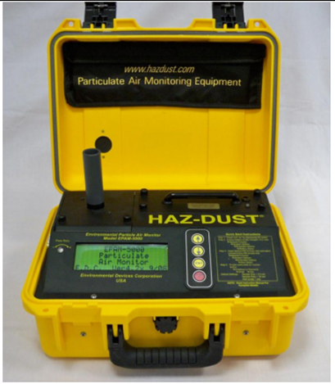
Assessing the Cost-Effectiveness of Wyoming’s CMAQ Unpaved Road Dust Suppression Program

Slide 51

CMAQ Funds
help reduce PM₁₀ emissions (particulate matter less than 10 μm in diameter).
one of the U.S. Environmental Protection Agency’s six criteria pollutants affecting air quality.
PM₁₀ is referred to as “inhalable coarse particles,”.

Slide 52
Project Benefits
Select best dust treatment based on
  Aggregate properties
  Traffic composition
  Climate
Help justify chemical treatment
Help in ranking treatments based on traffic characteristics
Provide information to the FHWA to justify the CMAQ program

Slide 53
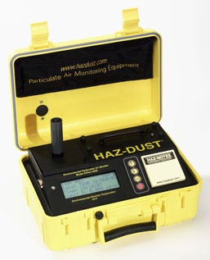
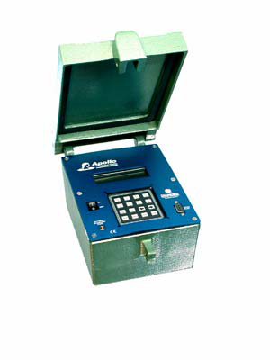

Loan Programs
  Traffic Counters (50)
  Retro Reflectometer (2)
  Dust Monitors (2)

Slide 54
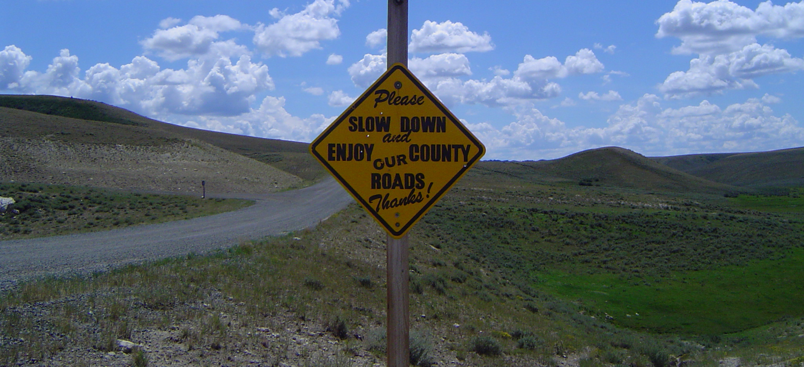
Questions?
Notes:
Oil and Gas Project/Presentation 9-27-2012/Condition Charts v2.xlsx

